Slide 1
Chapter 9: Understanding the Atom

Slide 2
Lesson 1: Discovering Parts of an Atom
Vocabulary words: atom, electron, nucleus, proton, neutron, electron cloud

Slide 3
Early Ideas About Matter
2,000 years ago, Greek philosophers thought that all matter is made of only four elements- fire, water, air, and earth.
They were not able to test the ideas because the scientific tools and methods were not developed yet.
Most influential philosophers ideas were accepted

Slide 4
Aristotle
He did not believe that empty space exists.
He believed that all matter is made of fire, water, air, and earth.
Because he was so influential, his ideas were accepted.
Democritus (460-370 B.C.) was a philosopher who challenged that idea of matter.

Slide 5
Democritus
He believed that matter is made of small, solid objects that cannot be divided, created, or destroyed.
These are called atoms
He proposed that different types of matter are made up of different types of atoms.
He also proposed that nothing lies between these atoms except empty space.
Democritus’s ideas were not studied for more than 2,000 years (and his are similar to what scientists think today).

Slide 6
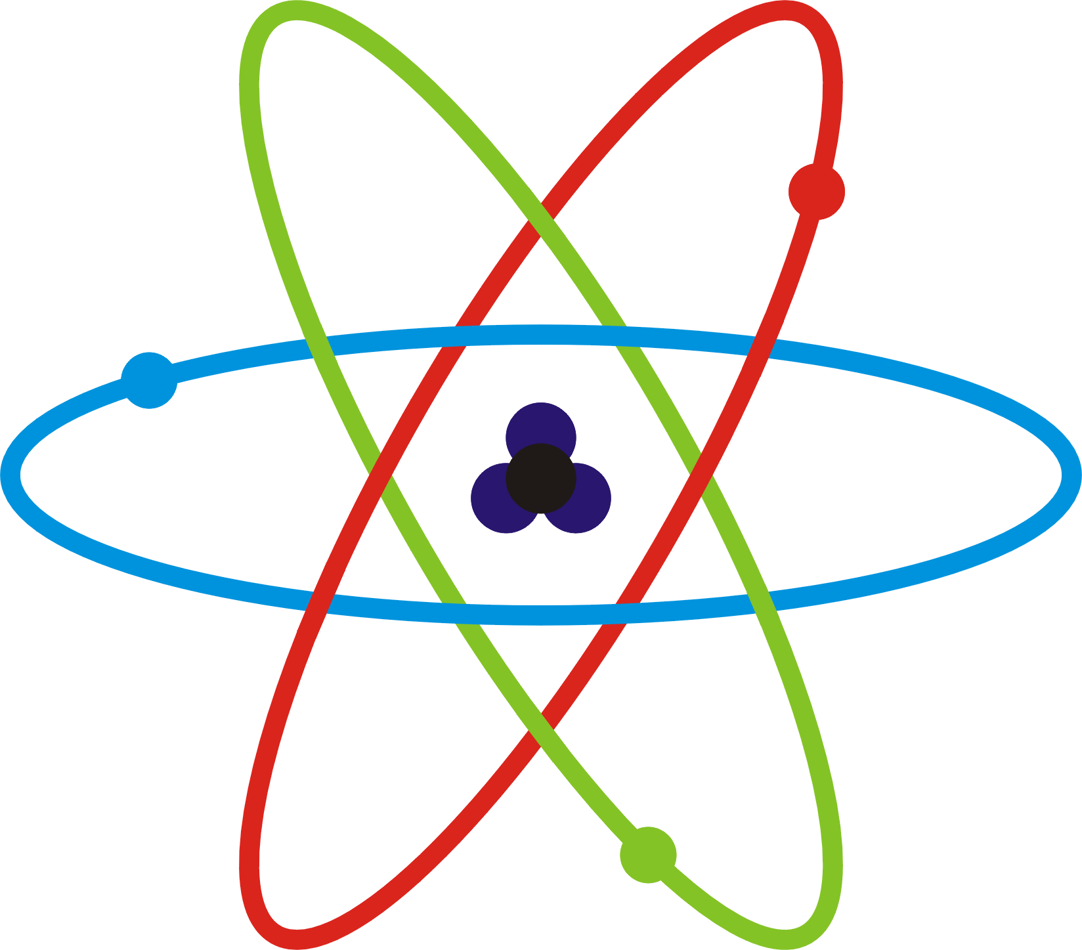
The Atom
Today, scientists believe:
Matter is made of atoms with empty space in between them
An atom cannot be divided into smaller pieces
An atom is the smallest piece of an element that still represents that element.

Slide 7
Thomson- Discovering Electrons
J.J. Thomson worked with cathode ray tubes
Neon sign, computer monitor, ATM screen
A glass tube with pieces of metal called electrodes inside the tube.
Electrodes are connected to a wire which is connected to a battery
He discovered that if the air was removed and electricity passed through the wires, greenish-colored rays traveled from an electrode to the other end of the tube.

Slide 8
Negative Particles
Thomson wanted to know if the rays had an electric charge.
Opposite charges attract; Like charges repel
He placed two plates (+ & -) on opposite sides of the tube.
Rays bent towards the the positive plate and away from the negative plate.
In conclusion, the cathode rays are negatively charged.

Slide 9
Parts of Atoms
These rays were made of particles that were even smaller than atoms.
Thomson concluded that cathode rays were made of small, negatively charged particles.
Electron is a particle with one negative charge.
Because atoms are neutral, Thomson proposed that atoms also must contain a positive charge that balances the negatively charged electrons.

Slide 10
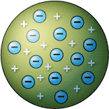
Thomson’s Atomic Model
It contains both positive and negative charges.
It contains a positively charged sphere with negatively charged electrons within it.
Similar to a chocolate chip cookie

Slide 11
Rutherford- Discovering the Nucleus
Ernest Rutherford was a student of Thomson.
Rutherford’s students tested Thomson’s atomic model and discovered another surprise.

Slide 12
Rutherford’s Predicted Result
Students expected the path of the alpha particle to travel straight through the foil without changing direction.
Reasons why?
Alpha particles are dense and positively charged
Another dense particle would be needed to change its path
The atom is too spread out and not dense enough to change the path of the alpha particle
Electrons do not have enough mass to affect the path either

Slide 13
The Gold Foil Experiment
The students placed a source of alpha particles near gold foil.
A screen surrounded the gold foil.
You could determine the path of the alpha particles by looking at the spot on the screen.

Slide 14
The Surprising Result
Most of the particles did travel in a straight path through the foil (what was expected).
Some bounced off to the side.
The alpha particles must have hit something dense and positively charged inside the nucleus.
Thomson’s model had to be altered.

Slide 15
Rutherford’s Atomic Model
Rutherford made a few conclusion:
Atoms are mostly made up of empty space
Atom’s mass and positive charge is concentrated in the nucleus which is a small area in the center of the atom
The positive charge in the nucleus was made of positively charged particles called protons.
Negatively charged particles lay surrounding the nucleus amongst the empty space.

Slide 16
Discovering the Neutrons
James Chadwick researched atoms and discovered that the nucleus contains neutrons in addition to protons.
A neutron is a neutral particle that exists in the nucleus of an atom.

Slide 17
Bohr’s Atomic Model
Neils Bohr, a student of Rutherford, experimented with hydrogen.
He added electric energy and studied what was released
His experiments led to a revised atomic model.

Slide 18
Electrons in the Bohr Model
Bohr proposed that electrons move in circular orbits or energy levels around the nucleus.
In an energy level, there is a specific amount of energy
Electrons closer to the nucleus have less energy than electrons farther away from the nucleus
Electrons can gain energy move from a lower energy level to a higher energy level
When they return to the lower energy level, they release energy as light.

Slide 19
Limitations
Bohr reasoned that his model was accurate for atoms with one electron. Therefore, it must be correct for atoms with more than one electron.
Electrons do have a certain amount of energy.
However, they are not arranged in circular orbits.

Slide 20
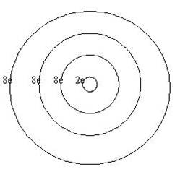
How to Draw Bohr Diagrams
1 level holds 2 electrons
2 level holds 8 electrons
3 level holds 8 electrons
Using the Atomic Number of the element, you must place the electrons in the particular orbit.
When placing them, start on the right and proceed counter clockwise. Place them one at a time until pairing them is necessary.

Slide 21
Lewis Dot Diagram
Only concerned with the valence electrons or the electrons that land in the outer shell.
The element’s group can help figuring out how many valence electrons there are.
An element is stable when its outer shell is full.
How many is that?
2 or 8
An element is very unstable when its outer shell is not full.
1 valence electron and 7 valence electron
Almost full!

Slide 22
The Modern Atomic Model
Electrons form an electron cloud which is an area around an atomic nucleus where an electron is most likely to be located.
Electrons are constantly moving around the nucleus but it is hard to know their exact location and speed.
Scientists can only predict a particular location.
Figure 10 shows mostly empty space.
Darker shades are areas where electrons are more likely to be.

Slide 23
Quarks
Protons and neutrons are made up of smaller particles called quarks.
Electrons are not made of smaller parts.
Six types of quarks
The current model of the atom may change with new technology that allows new discoveries.

Slide 24
http://www.youtube.com/watch?v=ulyopnxjAZ8

Slide 25
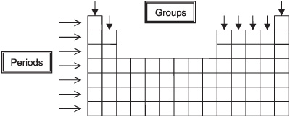

Slide 26
Lesson Two: Protons, Neutrons, and Electrons- How Atoms Differ

Slide 27
The Parts of the Atom
Protons and neutrons have about the same mass.
The mass of electrons is smaller than the mass of protons or neutrons.
Therefore, the mass of an atom is mainly found in the nucleus.
The number of these particles are different for different types of atoms.

Slide 28
Different Elements-Protons
An element made from atoms that have the same number of protons.
The number of protons in an atom of an element is the element’s atomic number.
The AN is the whole number listed with each element on the periodic table.
What makes an atom of one element different from an atom of another element?
They contain different number of protons

Slide 29
Different Elements
Neutral atoms of different elements also have different number of electrons.
The number of electrons equals the number of protons.
The number of positive charges equals the number of negative charges
Therefore, the atom is neutral.

Slide 30
Neutrons and Isotopes
Atoms of the same element have the same number of protons.
However, atoms of the same element have different number of neutrons.
For example, Carbon has six protons but can have six, seven, or eight neutrons.
These are called isotopes.
Most elements have isotopes.
An isotope is written with the element name followed by the mass number.
Carbon-12

Slide 31
Protons, Neutrons, and Mass Number
The Mass Number of an atom is the sum of the number of protons and neutrons in an atom.
Mass Number= protons + neutrons

Slide 32
Average Atomic Mass
The average atomic mass of an element is the average mass of the element’s isotopes, weighted according to the abundance of each isotope.
Table 3 shows three isotopes of carbon. Why isn’t the average 13 since the average of 12,13,& 14 is 13?
The average AM is weighted bases on how much of each isotope is present on Earth. Most of Earth’s carbon is carbon-12 which is why the AM 12.01.

Slide 33
Radioactivity
Pierre and Marie Curie discovered that the radiation released by uranium was made of energy and particles.
This radiation came from the nuclei of the uranium atom.
The number of protons in one atom of uranium changes.
When uranium releases radiation, it changes to a different element.

Slide 34
Types of Decay
Radioactive elements contain unstable nuclei.(does not hold together well)
They undergo nuclear reactions that form atoms of different AN or AM.
Nuclear decay is a process that occurs when an unstable atomic nucleus changes into another more stable nucleus by emitting radiation.
Nuclear decay can produce three different types of radiation by the unstable nucleus
Alpha particles, beta particles, and gamma rays

Slide 35
Alpha Decay
An alpha particle is made of two protons and two neutrons (like a helium nucleus).
When an atom releases an alpha particle, its atomic number decreases by 2 and the mass number by 4.
Alpha particles move fast but they can be stopped by collisions with atoms.
It can cause injury like a burn
A shield can be foil or paper.

Slide 36
Beta Decay
A neutron in an atom changes into a proton and high-energy electron called a beta particle.
The new proton becomes part of the nucleus and the beta particle (electron) is released.
The AN increases by 1 because it has gained a proton.
They travel faster than alpha particles.
They can travel through the human body and damage its cells.

Slide 37
Gamma Decay
They do not contain particles, but they do contain a lot of energy.
Similar to x-rays
It does not cause a change in either MN or the AN.
The energy releases is penetrating.
It can pass through thin sheets of lead
They can pass right through a human body and cause severe damage to cells.

Slide 38
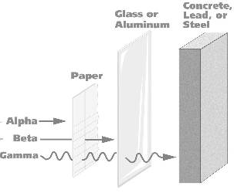
Sources of Radiation
This decay consists of two protons and two neutrons.
This decay is similar to an x-ray.
This decay emits a high-energy electron.
In this decay the mass number decreases by 4.
In this decay, the atomic number increases by 1.

Slide 39
Why isn’t Alpha and Beta decay on the electromagnetic spectrum? What is different between Alpha and beta versus Gamma?

Slide 40
Ions- Gaining and Losing Electrons
When electrons are added to or removed from an atom, that atom becomes an ion.
An ion is an atom that is no longer neutral because it has gained or lost electrons.

Slide 41
Positive Ions
An atom loses an electron.
It has more protons that electrons.
Therefore, it has a positive charge.
It can be called a positive ion or a cation.
It is represented by the element symbol followed by an exponent plus sign (Na⁺)

Slide 42
Negative Ions
An atom gains electrons.
It has more electrons than protons.
It has a negative charge.
An atom with a negative charge is called a negative ion or an anion.
It is represent by the element’s symbol followed by a subscript negative sign (F_)

