Slide 1
Chapter 9: Understanding the Atom

Slide 2
Lesson 1: Discovering Parts of an Atom
Vocabulary words: atom, electron, nucleus, proton, neutron, electron cloud

Slide 3
Early Ideas About Matter
2,000 years ago, Greek philosophers thought that all matter is made of only four elements- __________________________________________.
They were not able to test the ideas because the scientific tools and methods were not developed yet.
Most influential philosophers ideas were accepted
_____________ (460-370 B.C.) was a philosopher who challenged that idea of matter.

Slide 4
Aristotle
He did not believe that ________________________ _________.
He believed that all matter is made of fire, water, air, and earth.
Because he was so influential, his ideas were accepted.
_____________ (460-370 B.C.) was a philosopher who challenged that idea of matter.

Slide 5
Democritus
He believed that matter is made of small, solid objects that cannot be divided, created, or destroyed.
These are called ___________________
He proposed that different types of matter are made up of different types of atoms.
He also proposed that nothing lies between these atoms except _________________________.
Democritus’s ideas were not studied for more than 2,000 years (and his are similar to what scientists think today).

Slide 6
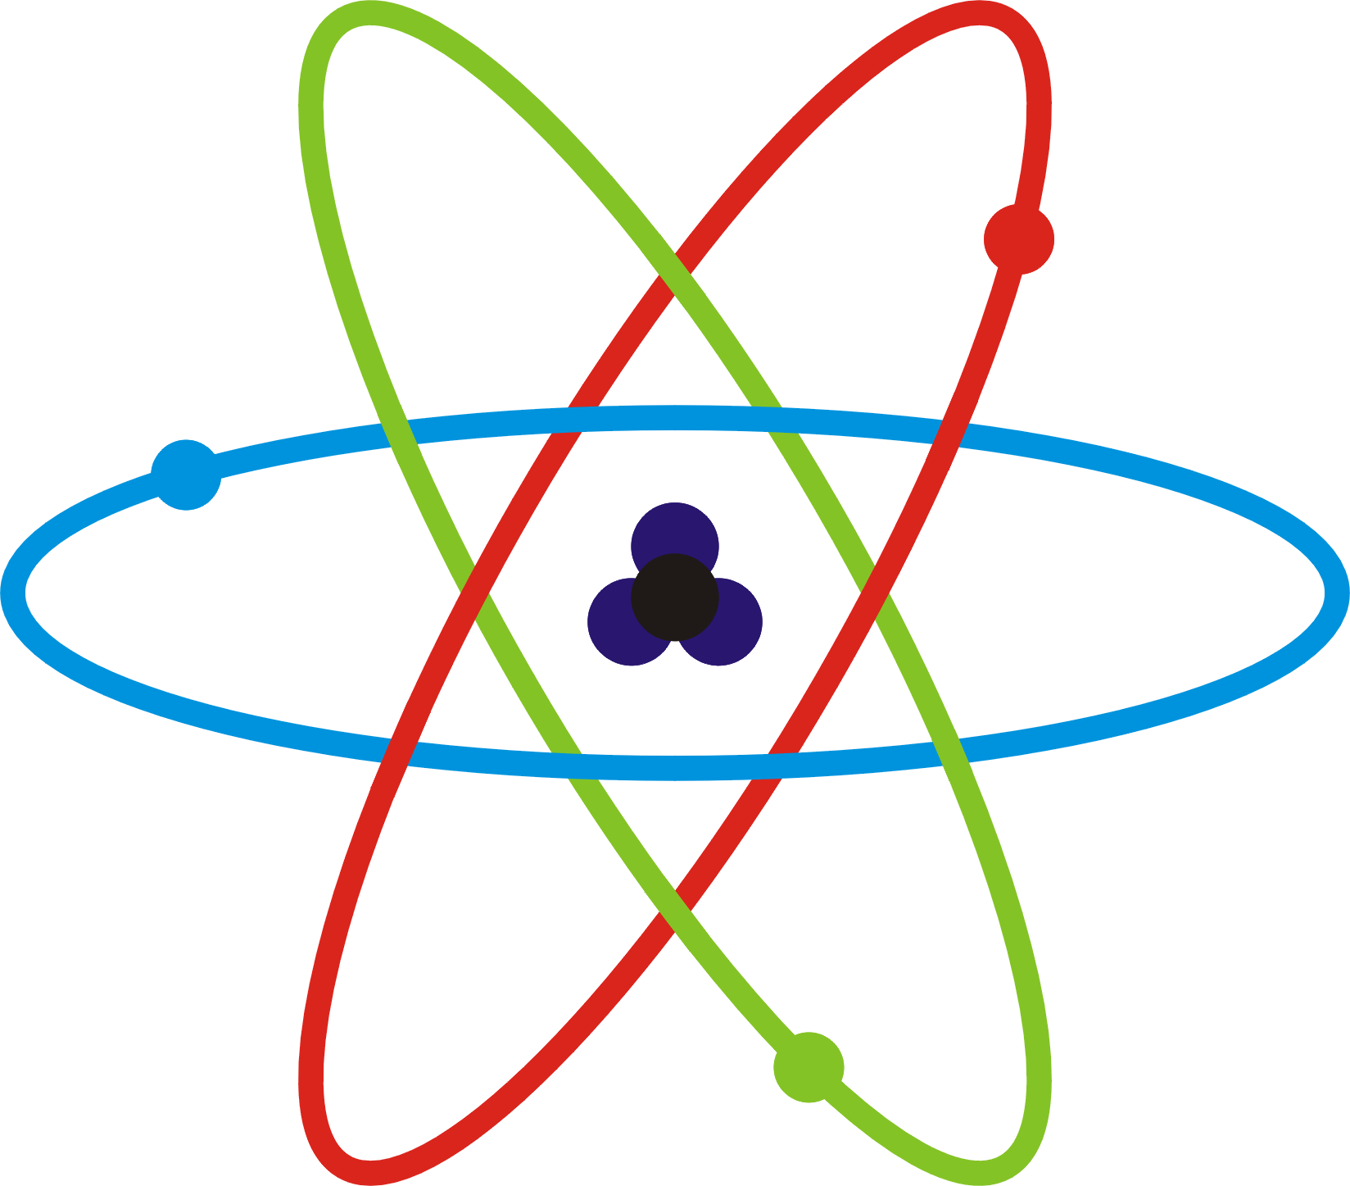
The Atom
Today, scientists believe:
Matter is made of atoms with empty space in between them
An atom ____________be divided into smaller pieces
An atom is the _____________piece of an element that still represents that __________________.

Slide 7
Thomson- Discovering Electrons
J.J. Thomson worked with ________________ ___________ tubes
Neon sign, computer monitor, ATM screen
A glass tube with pieces of metal called electrodes inside the tube.
Electrodes are connected to a wire which is connected to a battery
He discovered that if the air was removed and electricity passed through the wires, greenish-colored rays traveled from an ________________ to the other end of the tube.

Slide 8
Negative Particles
Thomson wanted to know if the rays had an electric charge.
Opposite charges __________; Like charges _______
He placed two plates (+ & -) on opposite sides of the tube.
Rays bent towards the the ___________ plate and away from the negative plate.
In conclusion, the cathode rays are __________________ charged.

Slide 9
Parts of Atoms
These rays were made of particles that were even smaller than atoms.
Thomson concluded that cathode rays were made of small, negatively charged particles.
_______________ is a particle with one negative charge.
Because atoms are neutral, Thomson proposed that atoms also must contain a _____________ charge that balances the negatively charged electrons.

Slide 10
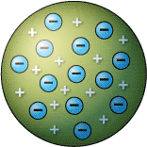
Thomson’s _________________
It contains both positive and negative charges.
It contains a positively charged __________ with negatively charged _____________within it.
Similar to a _________________________mixed in cookie dough

Slide 11
Rutherford- Discovering the Nucleus
___________________________ was a student of Thomson.
Rutherford’s students tested Thomson’s atomic model and discovered another surprise.

Slide 12
Rutherford’s Predicted Result
Students expected the path of the alpha particle to travel straight through the foil without changing direction.
Reasons why?
Alpha particles are ________and _________ charged
Another dense particle would be needed to change its path
The atom is too spread out and not dense enough to change the path of the alpha particle
Electrons do not have enough mass to affect the path either

Slide 13
The Gold Foil Experiment
The students placed a source of ________ ____________ near gold foil.
A screen surrounded the gold foil.
You could determine the path of the alpha particles by looking at the spot on the screen.

Slide 14
The Surprising Result
Most of the particles did travel in a ______________ path through the foil (what was expected).
Some bounced off to the side.
The alpha particles must have hit something ______________and ________________charged inside the nucleus.
Thomson’s model had to be altered.

Slide 15
Rutherford’s Atomic Model
Rutherford made a few conclusion:
Atoms are mostly made up of _______________
Atom’s mass and positive charge is concentrated in the ______________ which is a small area in the __________ of the atom
The positive charge in the nucleus was made of positively charged particles called ___________________.
Negatively charged particles lay surrounding the nucleus amongst the empty space.

Slide 16
Discovering the Neutrons
_________________________researched atoms and discovered that the nucleus contains neutrons in addition to protons.
A _____________________is a neutral particle that exists in the nucleus of an atom.

Slide 17
Bohr’s Atomic Model
____________________ , a student of Rutherford, experimented with hydrogen.
He added electric energy and studied what was released
His experiments led to a revised atomic model.

Slide 18
Electrons in the Bohr Model
Bohr proposed that electrons move in circular ______________________________around the nucleus.
In an energy level, there is a specific amount of ___________________
Electrons closer to the nucleus have _____ energy than electrons farther away from the nucleus
Electrons can gain energy move from a lower energy level to a higher energy level
When they return to the lower energy level, they release energy as _______________.

Slide 19
Limitations
Bohr reasoned that his model was accurate for atoms with one electron. Therefore, it must be correct for atoms with more than one electron.
Electrons do have a certain amount of ____________.
However, they are not arranged in circular orbits.

Slide 20
The Modern Atomic Model
Electrons form an ________________________ which is an area around an atomic nucleus where an electron is most likely to be located.
Electrons are constantly _______________ around the nucleus but it is hard to know their ___________ location and speed.
Scientists can only ______________ a particular location.
Figure 10 shows mostly empty space.
Darker shades are areas where electrons are more likely to be.

Slide 21
Quarks
Protons and neutrons are made up of smaller particles called ________________.
Electrons are not made of smaller parts.
Six types of quarks
The current model of the atom may change with new technology that allows new discoveries.

Slide 22
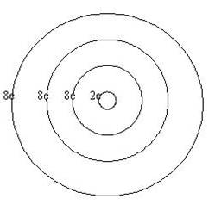
Electron Dot Diagram
1 level holds ___electrons
2 level holds ___electrons
3 level holds ___electrons
Using the _________________ of the element, you must place the electrons in the particular orbit.
When placing them, start on the right and proceed counter clockwise. Place them one at a time until pairing them is necessary.

Slide 23
Lewis Dot Diagram
Only concerned with the _________________ or the electrons that land in the __________________.
The element’s group can help figuring out how many valence electrons there are.
An element is __________ when its outer shell is full.
How many is that?
_________________
An element is very ____________ when its outer shell is not full.
____ valence electron and ____ valence electrons
Almost full!

Slide 24
http://www.youtube.com/watch?v=ulyopnxjAZ8

Slide 25
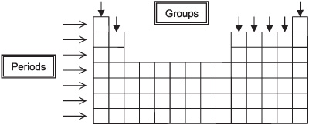

Slide 26
Lesson Two: Protons, Neutrons, and Electrons- How Atoms Differ

Slide 27
The Parts of the Atom
Protons and neutrons have about the same _____________.
The mass of electrons is _________________ than the mass of protons or neutrons.
Therefore, the mass of an atom is mainly found in the _________________.
The number of these particles are different for different types of atoms.

Slide 28
Different Elements-Protons
An element made from atoms that have the same number of protons.
The number of protons in an atom of an element is the element’s ___________________________.
The AN is the whole number listed with each element on the periodic table.
What makes an atom of one element different from an atom of another element?
They contain different number of _____________

Slide 29
Different Elements
Neutral atoms of different elements also have different number of electrons.
The number of electrons __________ the number of protons.
The number of positive charges equals the number of negative charges
Therefore, the atom is ________________.

Slide 30
Neutrons and Isotopes
Atoms of the same element have the same number of protons.
However, atoms of the same element have different number of _________________.
For example, Carbon has six protons but can have six, seven, or eight neutrons.
These are called ____________________.
Most elements have isotopes.
An isotope is written with the element name followed by the mass number.
Carbon-12

Slide 31
Protons, Neutrons, and Mass Number
The Mass Number of an atom is the sum of the number of protons and neutrons in an atom.
Mass Number= ___________+ ______________

Slide 32
Average Atomic Mass
The average atomic mass of an element is the average mass of the element’s isotopes, weighted according to the _________________ of each isotope.
Table 3 shows three isotopes of carbon. Why isn’t the average 13 since the average of 12,13,& 14 is 13?
The average AM is weighted bases on how much of each isotope __________________________________. Most of Earth’s carbon is carbon-12 which is why the AM 12.01.

Slide 33
Radioactivity
_____________________ discovered that the radiation released by uranium was made of energy and particles.
This radiation came from the nuclei of the ________________ atom.
The number of protons in one atom of uranium changes.
When uranium releases radiation, it changes to a different element.

Slide 34
Types of Decay
Radioactive elements contain _____________ nuclei.(does not hold together well)
They undergo nuclear reactions that form atoms of different AN or AM.
_________________is a process that occurs when an unstable atomic nucleus changes into another more _______________ nucleus by emitting radiation.
Nuclear decay can produce three different types of radiation by the unstable nucleus
_________ particles, _________particles, and _____________rays

Slide 35
Alpha Decay
An alpha particle is made of _________________ ____________________ (like a helium nucleus).
When an atom releases an alpha particle, its atomic number decreases by _____and the atomic mass by ____.
Alpha particles move fast but they can be stopped by collisions with atoms.
It can cause injury like a ________
A shield can be ______________.

Slide 36
Beta Decay
A neutron in an atom changes into a ________ and high-energy ____________ called a beta particle.
The new proton becomes part of the nucleus and the beta particle (electron) is released.
The AN increases by ___ because it has gained a proton.
They travel ________ than alpha particles.
They can travel through the human body and damage its cells.

Slide 37
Gamma Decay
They do not contain particles, but they do contain a lot of ____________.
Similar to ______________
It ___________ cause a change in either AM or the AN.
The energy releases is __________________.
It can pass through thin sheets of lead
They can pass right through a human body and cause ______________________________________.

Slide 38
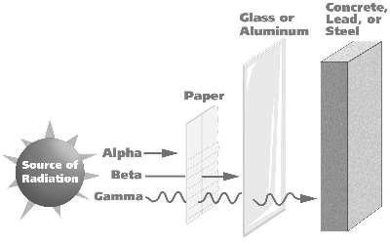
http://education-portal.com/academy/lesson/types-of-radioactive-decay-and-their-effect-on-the-nucleus.html

Slide 39
With the help of the periodic table, predict the element that forms in each case.
Uranium AM- 238 AN- 92 Alpha
Nickel AM- 63 AN- 28 Beta
Iodine AM- 131 AN- 53 Beta
Radium AM-226 AN- 88 Alpha

Slide 40
Ions- Gaining and Losing Electrons
When electrons are added to or removed from an atom, that atom becomes an _________.
An ion is an atom that is no longer neutral because it has _____________________________.

Slide 41
Positive Ions
An atom ____________________________.
It has more protons than electrons.
Therefore, it has a ____________ charge.
It can be called a positive ion or ___________.
It is represented by the element symbol followed by an exponent plus sign (Na⁺)

Slide 42
Negative Ions
An atom __________________________.
It has more electrons than protons.
It has a ________________charge.
An atom with a negative charge is called a negative ion or an ___________________.
It is represent by the element’s symbol followed by an exponent negative sign (F_)

