Slide 1
Chapter Two: The laws of motion

Slide 2
Lesson one: Gravity and Friction
Vocab words:
force, contact force, noncontact force, gravity, mass, weight, friction

Slide 3
Lesson 1: Gravity and Friction
Types of Forces
A push or pull on an object is called a force
Example: pushed toothpaste out of the tube or pulled a chair out
An object or a person can apply a force to another object or person.

Slide 4
Types of Forces
Contact Forces
A contact force is a push or pull on one object by another that is touching it.
Noncontact Forces
A force that one object can apply to another object without touching it is a noncontact force.
Gravity, the magnetic force, and the electric force are all examples.

Slide 5
Strength and Direction of Forces
Forces have both strength and direction.
What if you push a book away or push on the book?
Different things happen because the direction of the applied force is different.
Arrow lengths show the strength
Stronger=longer
Example: The tennis racquet vs. the table tennis paddle

Slide 6
Force
The SI unit for force is the Newton (N).

Slide 7
What is Gravity?
Gravity is an attractive force that exists between all objects that have mass.
Mass is the amount of matter in an object.
The Law of Universal Gravitation
In late 1600s, Sir Isaac Newton developed this law:
All objects are attracted to each other by a gravitational force.
The strength of the force depends on the mass of each object and distance between them.

Slide 8
The Law of Universal Gravitation
Gravitational Force and Mass
When the mass of one or both objects increases, the gravitational force between them also increases.
Each object exerts the same attraction on the other object.
Gravitational Force and Distance
The attraction between objects decreases as the distance between the objects increases.

Slide 9
Weight –A Gravitational Force
Weight is the gravitational force exerted on an object.
On Earth, the weight of an object in newtons is about ten times the object’s mass.
Weight and Mass High Above Earth
The moon’s gravity is 1/6
APP!!

Slide 10
Friction
Slide across the floor in your socks- you move quick and then stop
The force that stops you is friction
Friction is a force that resists the motion of two surfaces that are touching.
Static Friction
Figure 7 on page 49
Box does not move because the girl’s applied force is balanced by static friction

Slide 11
Static Friction
Static Friction prevents surfaces from sliding past each other
Up to a limit, the strength of static friction changes to match the applied force
There is a maximum amount of static friction to stop the object from moving
If the girl increases her applied force, will box move?
No because the static friction will also increase

Slide 12
Sliding Friction
When static friction reaches its limit between surfaces, the box will move.
Sliding friction opposes the motion of surfaces sliding past each other.
As long as it slides, the sliding friction does not change.
Increasing the applied force makes the box slide faster.

Slide 13
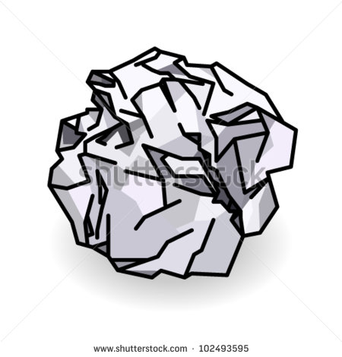
Fluid Friction
Friction between a surface and a fluid is fluid friction.
Fluid friction between a surface and air is air resistance.
Decreasing the surface area toward the oncoming fluid decreases the air resistance against the object.
Versus

Slide 14
Air Resistance
An example of a contact force
A falling object will meet the upward force of air resistance.
Increased surface area increases the air resistance
Air resistance increases
Terminal velocity is reached when air resistance on an object is equal to gravity. The object will no longer accelerate.

Slide 15
Lesson two: newton’s first law of motion
Vocab words: net force, balanced force, unbalanced force, Newton’s first law of motion, inertia

Slide 16
Identifying Forces
Combining Forces- Net Forces
When two or more forces act on an object, forces combine.
The combination of all the forces acting on an object is the net force.
The way in which forces combine depends on the directions of the forces applied to the object.

Slide 17
Identifying Forces
Combining Forces in the Same Direction
The direction of the net force is the same as the direction of the individual forces.
Combining Forces in Opposite Directions
The net force is the sum of the positive and negative forces

Slide 18
Identifying Forces
Balanced and Unbalanced
When two forces acting on an object in opposite directions are the same strength, the forces are balanced.
The net force is zero
Forces acting on an object that combine and form a net force that is not zero are unbalanced forces.

Slide 19
Therefore…
Unbalanced forces put a stationary object into motion (produce acceleration) or change the velocity of a moving object.
Balanced forces produce a lack of motion or steady velocity.
Never cause a change in an objects motion.
- If an object is stopped it remains stopped.
- If an object is in motion at a constant speed it remains in motion at a constant speed.

Slide 20
Newton’s First Law of Motion
Law of Inertia
An object at rest will stay at rest and an object in motion will remain in motion at a constant velocity unless acted upon by an unbalanced force.
Balance Forces and Motion
Balanced forces cause no change in an object’s velocity
This is true when an object is at rest or in motion
Figure 13 and 14

Slide 21
Newton’s First Law of Motion
Unbalanced Forces and Motion
When unbalanced forces act on an object at rest, the object starts moving
When unbalanced forces act on an already moving object, the object’s speed, direction of motion, or both change.

Slide 22
Newton’s First Law of Motion
Inertia
The tendency of an object to resist a change in its motion
The motion of the crash-test dummy explains inertia
Before the crash:
If no other force acted on them:
The unbalanced force (the impact with the barrier):
The dummy:

Slide 23
On Earth, friction can be reduced not removed
For an object to move, a force greater than static friction must be applied to it
To keep the object moving, a force at least as strong as friction must be applied continuously
Objects stop moving when friction or another force acts on them.

Slide 24
Lesson three: newton’s second law of motion
Vocab words: Newton’s second law of motion, circular motion, centripetal force

Slide 25
Unbalanced Forces
When unbalanced forces act on an object at rest, the object begins moving in the direction of the net force.
Unbalanced Forces on an Object in Motion
Unbalanced forces change the velocity of a moving object.
One way to change an object’s velocity is to change its speed

Slide 26
Unbalanced Forces on an Object in Motion
Speeding Up
If the net force acting on a moving object is in the direction that the object is moving, the object will speed up.
Slowing Down
If the net force on an object is opposite to the direction the object moves, the object slows down
When the boy pushes his foot against the snow, what is created?
Friction acts in the opposite direction to his motion

Slide 27
Changes in Direction of Motion
Unbalanced forces can change an object’s velocity by changing its direction
Think about a game of pool
The ball is moving a constant velocity until it hits the rail.
The applied force by the rail changes the ball’s direction

Slide 28
Newton’s Second Law of Motion
The net force on an object is equal to the product of its acceleration and its mass.
Force= mass x acceleration
F= ma
** Newton is the same as kg*m/s²**

Slide 29
Sample Problem
A 52 kg water- skier is being pulled by a speedboat. The force causes her to accelerate at 2 m/s/s.
Calculate the net force that cause this acceleration.
Force= mass x acceleration
Force = 52kg x 2 m/s/s
Force = 104 N

Slide 30
Changes in Force and Mass
You can increase acceleration by increasing force.
You can decrease acceleration by decreasing force.
You can increase acceleration by decreasing mass.
You can decrease acceleration by increasing the mass.

Slide 31
Examples
You throw a 0.5 kg basketball with a force of 10 N. What is the acceleration of the ball?
A 24-N net force acts on an 8-kg rock. What is the acceleration of the rock?
A 30-N net force on a skater produces an acceleration of 0.6 m/s². what is the mass of the skater?
What net force acting on a 14-kg wagon produces an acceleration of 1.5 m/s²?

Slide 32
Calculate Weight
Weight is a measure of gravity on an object on Earth.
Weight is a force. The unit of weight is NEWTON!
Weight = mass x acceleration
Acceleration will always be due to gravity!
Acceleration due to gravity is 9/8 m/s/s!!

Slide 33
Gravity
Free fall
When the only force acting on an object is gravity
Projectile Motion
An object that is thrown. An object in projectile motion and on object dropped straight down will hit the ground at the same time!

Slide 34
LESSON FOUR: NEWTON’S THIRD LAW OF MOTION
Vocab words: Newton’s Third Law of Motion, force pair, momentum, law of conservation of momentum

Slide 35
Opposite Forces
Newton’s Third Law of Motion
Relates to two objects
For every action, there is an equal and opposite reaction.

Slide 36
Force Pairs
The forces depend on each other.
A force pair is the forces two objects apply to each other.
If the forces of a force pair always act in opposite directions and are always the same strength, do they cancel each other out?
No, because each force acts on a different object.

Slide 37
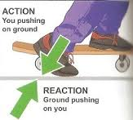
Net force is not zero because they are acting on different objects
Adding forces can only result in a net force of zero, in this case, if the forces act on the same object.

Slide 38
Using Newton’s Third Law of Motion
Swimming
Action force is against the water in the pool
Reaction force is against you
If your arms push the water back with enough force, the reaction of the water on your body is greater than the force of fluid friction.
The net force is forward
You accelerate in the direction of the net force and swim forward through the water

Slide 39
Circular Motion
A circular motion is any motion in which an object is moving along a curved path.
In circular motion, a force that acts perpendicular to the direction of motion, toward the center of the curve, is centripetal force.

Slide 40
Centripetal Force
The path of inertia shows its tendency to stay on a straight path and creates motion.
However, the path is curved because of the string= circular motion.
Acceleration is in the direction of the centripetal force.

Slide 41
The Motion of Satellites and Planets
Satellite
What does inertia want it to do?
Stay in a straight path
What is the centripetal force?
Gravity is the centripetal force that keeps a satellite in orbit by changing its direction
Keeps it inward
What about a car making a turn?

Slide 42
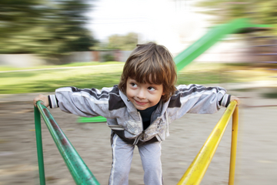
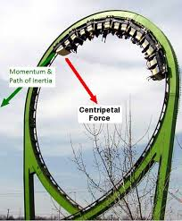
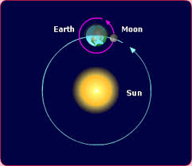
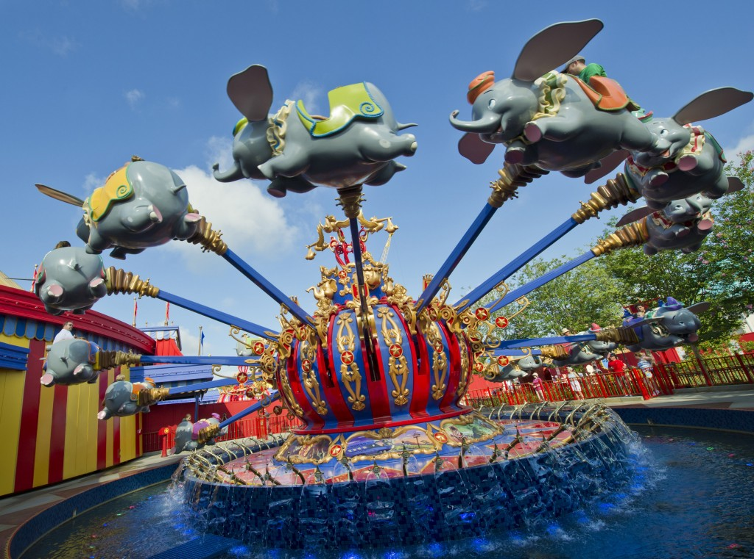
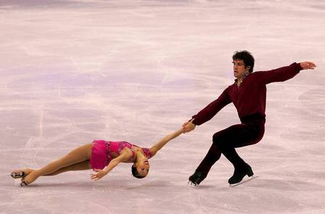
WHY ARE ALL OF THESE EXAMPLES OF CENTRIPETAL FORCE?

Slide 43
Momentum
Momentum is a measure of how hard it is to stop a moving object.
It is the product of an object’s mass and velocity
It is in the same direction as its velocity
momentum (kg*m/s)= mass (kg) * velocity (m/s)
p= m * v

Slide 44
Which is harder to stop? A large truck or car
Truck is harder to stop because it has more mass and more momentum
What if the car and truck are equal in mass but move at different speeds?
The one that moves faster has greater momentum.

Slide 45
Conservation of Momentum
If a moving ball hits another ball that is not moving, the motion of both balls changes.
The cue ball has momentum because it has mass and is moving
When the cue ball hits the other balls, the cue ball’s velocity and momentum decrease
The other billiard balls start moving
These have mass and velocity; they also have momentum

Slide 46
The Law of Conservation of Momentum
The billiard balls gain momentum that the cue ball lost
The total momentum does not change
The law states: The total momentum of a group of objects stays the same unless outside forces act on the objects
Outside forces include friction
Friction between the balls and the table decreases their velocities and they lose momentum

Slide 47
Types of Collisions
Elastic collisions
When colliding objects bounce off each other
Inelastic collision
When objects collide and stick together
Such as when one football player tackles another
No matter the type of collision, the total momentum will be the same before and after the collision

Slide 48
http://www.sciencechannel.com/games-and-interactives/newtons-laws-of-motion-interactive.htm

