Slide 1
Unit 1: Motion & Forces
Chapter 1: Describing Motion

Slide 2
Lesson One
Position and motion
Vocabulary words: reference point, position, motion, distance, displacement

Slide 3
Describing Position
How would you describe where you are sitting right now?
Each description states your location relative to a certain point.
A reference point is the starting point you choose to describe the location, or position, of an object.
What is the reference point in your example?

Slide 4
Describing Position
Each description of your location also includes your distance and direction from the reference point.
This describes your position
A position is an object’s distance and direction from a reference point.
Includes a distance, direction, and reference point

Slide 5
Launch Lab
Groups
How do you get to the:
Door?
Windows?
Podium?
Based on the answers that have been discussed, what can you conclude?

Slide 6
***The distance and direction to a location can change if the reference point changes.***

Slide 7
Using a Reference Point to Describe Position
First, choose a reference point
Next, describe the direction from the reference point
Finally, measure/estimate the distance from the reference point
Example on page 10

Slide 8
Changing the Reference Point
The description of an object’s position depends on the reference point.
Look at page 10 for the example
The description of the table’s position changed because the reference point is different.
Its actual position did not change.

Slide 9
The Reference Direction
When you describe an object’s position, you compare its location to a reference direction.
The reference direction is the positive direction while the direction opposite to the reference direction is the negative direction.
Page 11 Figure 2
East is the reference direction
Where is the museum from the bus stop? Library?

Slide 10
Describing Position in Two Dimensions
Sometimes you need to describe an object’s position using more than one direction.
When you describe a position using two directions, you are using two dimensions.
A dimension is the distance or length measured in one direction.
Reference Directions in Two Dimensions
You may choose north, south, east, or west as reference directions.
Or you can use right, left, up, and down

Slide 11
Describing Changes in Position
Motion is the process of changing position.
You need to be able to describe how an object’s position changes.
Motion Relative to a Reference Point
Look at figure 4 on page 13
If the reference point is the pole, is the man in motion?
If the reference point is the buoy, is the man in motion?

Slide 12
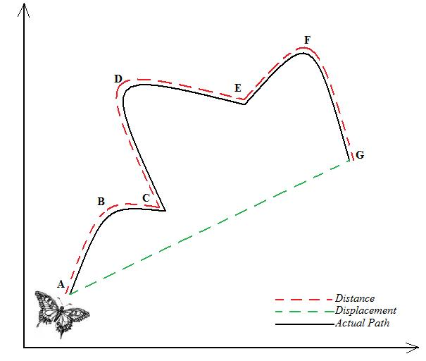
Distance and Displacement
Figure 5 on page 13
Distance is the length of the path
Displacement is the difference between the initial (first) position and the final position of an object

Slide 13
Calculating Displacement:
When finding the displacement, Ask yourself these questions:
Are you starting where you are finishing?
If you are, the displacement is 0.
If you are not, the displacement is not 0
Proceed to the next question.
Is the motion in one direction?
If it is, the distance and displacement are equal.
If it is not, the distance and displacement are not equal.
Find the shortest route to the locations.

Slide 14
Lesson 2
Speed and velocity
Vocabulary words: speed, constant speed, instantaneous speed, average speed, velocity

Slide 15
Speed
Speed is a measure of the distance an object travels per unit of time.
Units of Speed
Calculate speed by dividing the distance traveled by the time it takes to go that distance
The units of speed are units of distance by units of time
Meters per second

Slide 16
Constant Speed
Constant speed is the rate of change of position in which the same distance is traveled each second.
Figure 6
Each second, the car moves 11 m/s.
Because it moves the same distance each second, its speed is not changing.

Slide 17
Changing Speed
Figure 6
Because the car travels a different distances each second, its speed is changing.
Instantaneous speed is speed at a specific instant in time.
You can see a car’s instantaneous speed on its speedometer.

Slide 18
Average Speed
Average speed is the total distance traveled divided by the total time taken to travel that distance.
Average speed = total distance (m) / total time (s)
S= d/t
Page 19 problems 1 & 2

Slide 19
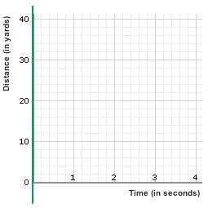
Distance-Time Graphs
When you study motion, two measurements frequently compared to each other are distance and time.
The graphs that show
these comparisons are
called distance-time
graphs.

Slide 20
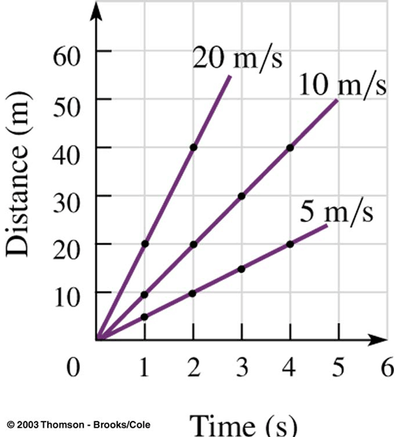
Comparing Speeds on a Distance-Time Graph
You can use distance-time graphs to compare the motion of two different objects.
Steeper lines on the distance-time graphs indicate faster speeds.
Page 21

Slide 21
Using a Distance-Time Graph to Calculate Speed
Steps needed to calculate the average speed:
Choose the first point on the line
Choose the last point on the line
Find the distance difference of the points
Find the time difference of the points
Divide the difference in distance by the difference in time

Slide 22
Distance-Time Graph and Changing Speed
Different types of speed are illustrated on a D-T graph:
Constant speed: a straight diagonal line
Stopping: A horizontal line indicates that there is no motion.
The speed of the train changes instead of being constant, its motion on a distance-time graph is a curved line.
Slowing down: the downward curve indicates the train slowed down
Speeding up: the upward curve indicates that the train was speeding up.

Slide 23
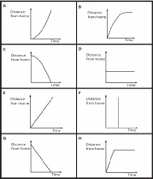

Slide 24
Continued…
To Find Average Speed for Changing D-T graphs
Choose a starting and ending point
Determine the change in distance and the change in time between these two points
Divide the difference in distance over the difference in time

Slide 25
Velocity
Velocity is the speed and direction of a moving object.
Representing Velocity
Can be represented by an arrow
Length of the arrow indicates the speed
Greater speed = longer arrow
Arrow points in the direction of the object’s motion
In figure 11, are the velocities the same?

Slide 26
Velocity
Changes in Velocity
Velocity changes when the speed of an object changes, when the direction that the object moves changes, or when both the speed and the direction change.
Look at figure 12 on page 23, is there two arrows the same?

Slide 27
Lesson 3
Acceleration
Vocabulary words: acceleration

Slide 28
Acceleration- Changes in Velocity
When a car’s velocity changes, the car is accelerating.
Acceleration is a measure of the change in velocity during a period of time.
An object accelerates when its velocity changes as a result of speeding up, slowing down, or changing direction.
Think about a roller coaster

Slide 29
Representing Acceleration
Acceleration has a direction and can be represented by an arrow.
The length of the arrow indicates the amount of acceleration
An arrow’s direction depends on whether velocity increases or decreases

Slide 30
Figure 13 on page 28
Speeding Up
Initial velocity arrow is short because its moving slowly
Final velocity arrow is longer because the speed increases
As velocity increases, the car accelerates → arrow is in same direction as velocity

Slide 31
Figure 13 page 28
Slowing Down
Initial velocity arrow is long because it is moving fast
Final velocity arrow is shorter because it is slowing down
When velocity decreases, acceleration and velocity are in opposite directions.
The acceleration arrow points in the direction opposite to the direction the car is moving.

Slide 32
Figure 13 page 28
Changing Direction
Constant speed→ velocity arrow is the same length at each point
The car’s velocity changes because its direction changes
Therefore, the car is accelerating.
Acceleration is the change in velocity
Acceleration is towards the inside of the curve

Slide 33
Calculating Acceleration
If an object moves in one direction, you can calculate its average acceleration using this equation:
Average acceleration =final speed – initial speed(m/s)
total time (s)
a (in m/s²⁾= V_{f} – V_{i} / t
For example, a bicyclist started from rest along a straight path. After 2.0 s, his speed was 2.0 m/s. After 5.0 s, his speed was 8.0 m/s. What was his average acceleration during the time 2.0 s to 5.0 s?
Now try: page 29 Practice problem

Slide 34
Speed-Time Graphs
This shows how speed changes over time
Horizontal axis (x-axis) → time
Vertical axis (y-axis) → speed
An object at rest
Is not moving, so its speed is always zero

Slide 35
Speed-Time Graphs
Constant Speed
The plotted line is horizontal.
The object’s speed does not change.
The speed of the object is represented by the distance the horizontal line is from the x-axis.
Farther from the x-axis→ the object is moving at a faster speed

Slide 36
Speed- Time Graphs
Speeding Up
Speed of a plane increases at a steady rate
At the beginning of the time period, the line is closer to the x-axis because the plane has a lower speed
The speed of the object increases at a steady rate over time.
Graph slants upward to the right

Slide 37
Speed- Time Graphs
Slowing Down
Initial: moving at a high speed→ point is far from x-axis
As speed decreases→ the points are getting closer to the x-axis
Line touches the x-axis → speed is 0 and stops
The speed of the object decreases at a steady rate over time
Graph slopes downward to the right

Slide 38
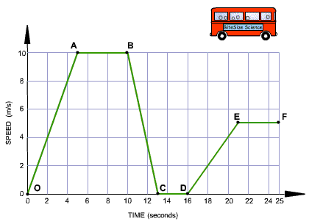
Label the Points

