Slide 1
Chapter 1: Describing Motion
Motion & forces

Slide 2
Lesson One: Position and Motion
Vocabulary words:
reference point, position, motion, distance, displacement

Slide 3
Describing Position
How would you describe where you are sitting right now? ______________________________
Each description states your location relative to a certain point.
A reference point is _____________________
____________________________________
____________________________________
What is the reference point in your example?
___________________________________

Slide 4
Describing Position
Each description of your location also includes your _____________________
_______________________________ from the reference point.
This describes your position
A position is an _________________
__________________________________________________________

Slide 5
Launch Lab
Groups
How do you get to the:
Door? _______________________
Windows? ____________________
Podium? _____________________
Based on the answers that have been discussed, what can you conclude? ______
______________________________________________________________

Slide 6
Conclusion:
*** ____________________________
_______________________________
___________________________________________________________ ***

Slide 7
Using a Reference Point to Describe Position
First, choose a ___________________
Next, describe the __________________
______________________________
Finally, measure/estimate the ____________________________________________________________
Example on page 10

Slide 8
Changing the Reference Point
The __________________________ ___________________depends on the ___________________.
Page 10 for the example
The description of the table’s position changed because the reference point is _________________.
____________________________________________________________

Slide 9
The Reference Direction
The reference direction is the _________ ______________ while the direction ______________________________ is the ________________________.
Page 11 Figure 2: _______is the reference direction
Where is the museum from the bus stop? Library? _______________________________________

Slide 10
Dimensions
A dimension is ___________________
__________________________________________________________
Two directions= __________________
What kind of directions can you use?
__________________________________________________________

Slide 11
Describing Changes in Position
Motion is the _____________________________________________________________________________

Slide 12
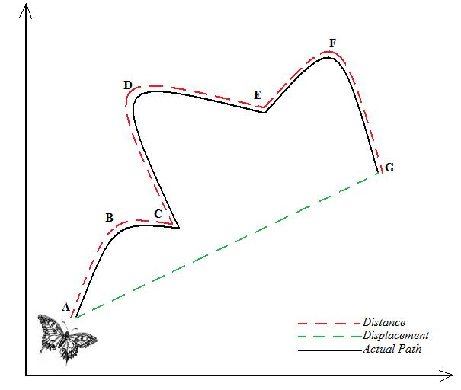
Distance and Displacement
Distance is ________
____________________________________
Displacement is ________________
______________________________________________________
__________________

Slide 13
Calculating Displacement:
When finding the displacement, Ask yourself these questions:
Are you starting where you are finishing?
If you are, the displacement is _________.
If you are not, the displacement is not ________.
Proceed to the next question
Is the motion in one direction?
If it is, the distance and displacement are ______.
If it is not, the distance and displacement are not ________.
Find the shortest route to the locations.

Slide 14
Lesson 2: Speed and Velocity
Vocabulary words:
speed, constant speed, instantaneous speed, average speed, velocity

Slide 15
Lesson 2: Speed and Velocity
Speed is a ______________________
______________________________
Units of Speed
Calculate speed by ________________ __________________________________________________________
The units of speed are units of distance by units of time
____________ per ____________

Slide 16
Types of Speed
Constant speed is __________________
____________________________________________________________
Instantaneous speed is ______________
______________________________
You can see a car’s instantaneous speed on its ________________.
Changing speed ___________________
______________________________

Slide 17
Average Speed
Average speed is _____________________
_________________________________
_________________________________
Average speed = ____________(m) / ______________(s)
S= ____________
Page 19 problems 1 & 2

Slide 18
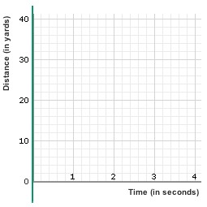
Distance-Time Graphs
When you study motion, _____________ _____________ frequently compared to each other are __________________.
The graphs that show
these ___________are
called _____________
__________________.

Slide 19
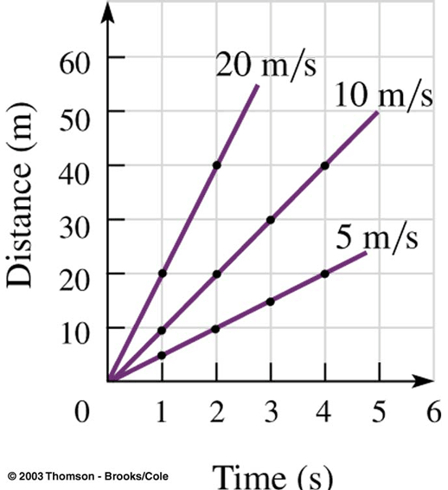
Comparing Speeds on a Distance-Time Graph
You can use distance-time graphs to ____________________________________________________________.
_____________on the distance-time graphs indicate
_____________.

Slide 20
Using a Distance-Time Graph to Calculate Speed
Steps needed to calculate the average speed:
Choose the ___________ on the line
Choose the ___________ on the line
Find the ________________ of the points
Find the ________________ of the points
__________________ in distance by the difference in time

Slide 21
Speeds on D-T Graph
Different types of speed on a D-T graph:
Constant speed: a _________ ___________ line
Stopping: A ___________line indicates ______________________________________.
The speed of the train changes instead of being constant, its motion on a distance-time graph is a curved line.
Slowing down: the _________ curve indicates the train ______________________
Speeding up: the __________ curve indicates that the train was _____________________.

Slide 23
Velocity
Velocity is the _______________________
_________________________________
Representing Velocity
Can be represented by an ___________
________________________indicates the speed
____________speed = __________arrow
_______________________________ of the object’s motion

Slide 24
Velocity
Changes in Velocity
Velocity changes when the___________ _____________________________, when the _______________________ _________________________, or when _________________________
_____________________________

Slide 25
Lesson 3: Acceleration
Vocabulary words: acceleration

Slide 26
Acceleration
When a car’s ___________________, the car is _______________.
Acceleration is a __________________
______________________________
An object accelerates when its velocity changes as a result of _______________ _____, _____________________, or _______________________.
Think about a roller coaster

Slide 27
Representing Acceleration
Acceleration has a _________________
______________________________.
The ___________________indicates the ______________________________
An arrow’s direction depends on ____________________________________________________________

Slide 28
Figure 13 on page 28
Speeding Up
___________________arrow is short because its ________________
_________________arrow is longer because the speed _______________
As velocity ___________________, the car accelerates → arrow is in ____________________________

Slide 29
Figure 13 page 28
Slowing Down
___________arrow is long because it is _______________________
_____________arrow is shorter because it is _________________
When velocity ___________, acceleration and velocity are in _______________________.
The acceleration arrow points in the direction __________________________________________________________________.

Slide 30
Figure 13 page 28
Changing Direction
_________ speed→ velocity arrow is the _____________________________
The car’s ___________changes because its _________________________
Therefore, the car is ____________.
Acceleration is the _________________
______________________________________________________________

Slide 31
Calculating Acceleration
Average acceleration =
a ( in ______/ ______²)=
For example, a bicyclist started from rest along a straight path. After 2.0 s, his speed was 2.0 m/s. After 5.0 s, his speed was 8.0 m/s. What was his average acceleration during the time 2.0 s to 5.0 s?
Now try: page 29 Practice problem

Slide 32
Speed-Time Graphs
This shows how speed changes over time
Horizontal axis (x-axis) → ______
Vertical axis (y-axis) → _______

Slide 33
Speed-Time Graphs
An object at rest
Is ___________, so its speed is always ________
Constant Speed
The plotted line is ______________.
_____________from the x-axis→ the object is moving at a ________________
Speeding Up
The speed of the object ______________at a steady rate over time.
Graph _______________________________
Slowing Down
Graph _______________________________

Slide 34
Label the Points

