Slide 1
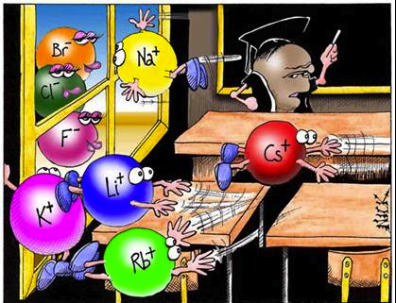
Chapter 11: Elements and Chemical Bonds

Slide 2
Lesson 1:Electrons & Energy Levels
Vocab words: chemical bond, valence electron, electron dot diagram

Slide 3
Atoms Bond
Pure elements are rare. Atoms of different elements chemically combine and form compounds.
Compounds make up most of the matter around you.
Chemical bonds hold them together.
A chemical bond is a force that holds two or more atoms together.

Slide 4
Electron Number and Arrangement
What do we know about electron number in a neutral atom?
The number of protons equal the number of electrons.
What do we know about the electron arrangement in an atom?
It cannot be determined exactly because of their constant movement.
In the electron cloud. Some close to nucleus and some in areas farther away.

Slide 5
Electrons and Energy
Different electrons have different amounts of energy.
The areas around which the electrons move around the nucleus are called energy levels.
If an electron has the least amount of energy, where are they located?
Closest to the nucleus or the lowest energy level
If an electron has the greatest amount of energy, where are they located?
Farthest away or the highest energy level

Slide 6
Electrons and Bonding
The electrons closest to the nucleus of the same atom have a strong attraction to that nucleus.
The electrons farther away nucleus are weakly attracted to it. These outermost electrons can easily be attracted to the nucleus of other atoms.
This attraction between the + nucleus of an atom and the – electrons of another is what causes a chemical bond.

Slide 7
Valence Electrons
A valence electron is an outermost electron of an atom that participates in chemical bonding.
These electrons are the only electrons involved in chemical bonding.
The number of valence electrons in each atom of an element can help determine the type and the number of bonds it can form.
We already know how to find the valence electrons of atoms. (Figure 4 on page 384 for reference)
Groups 3-12 electrons varies

Slide 8
Electron Dot Diagrams
Electron dot diagram can help you predict how an atom will bond with other atoms.
The number of unpaired dots is often the number of bonds an atom can form.

Slide 9
Stable and Unstable Atoms
Noble gases are stable because they have 8 valence electrons.
Do not easily react or form bonds
Atoms with one to seven valence electrons are chemically unstable.
Atoms with unpaired dots are reactive.
They form bonds with other atoms.
They become more stable by forming bonds.
When an atom forms a bond, it gains, loses, or shares electrons with other atoms.

Slide 10
Lesson 2: Compounds, Chemical Formulas, and Covalent Bonds
Vocab words: covalent bonds, molecule, polar molecule, chemical formula

Slide 11
From elements to compounds
An element is made of one type of atom, but compounds are chemical combinations of different types of atoms.
Compounds properties are different than the element properties that make it up.
Chemical bonds joins the atoms together.
One way is by sharing valence electrons.

Slide 12
Covalent Bonds- Electron Sharing
Atoms can become stable by sharing electrons.
Nonmetals bond together by the sharing.
A covalent bond is a chemical bond formed when two atoms share one or more pairs of valence electrons.
The atoms then form a stable covalent compound.

Slide 13
Noble Gas Electron Arrangement
Hydrogen and oxygen
Hydrogen has one valence electron
Oxygen has six valence electron
Atoms are stable with 8: noble gas arrangement
To become stable, oxygen atom forms two bonds and hydrogen atom forms one bond (only two valence electrons)

Slide 14
Stable Electrons
An oxygen atom and each hydrogen atom share the electrons, and form two covalent bonds to become stable covalent compound.
Each bond contains two electrons: one from the H atom and one from the O atom
The valence electrons count for both atoms in the bond.
Hydrogen has two and oxygen has eight since it bond with two hydrogen atoms.
Makes it stable

Slide 15
Double and Triple Covalent Bonds
Single covalent- 2 atoms share one pair of valence electrons.
Double covalent- 2 atoms share two pairs of valence electrons.
Triple covalent- 2 atoms share three pairs of valence electrons.
Single > double > triple
Figure 8 on page 392

Slide 16
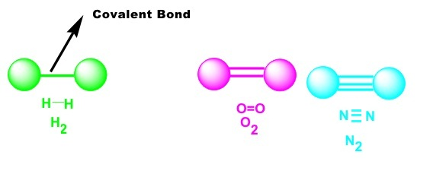
Find the type of covalent bond.
H₂
O₂
N₂

Slide 17
Covalent Compounds
When two or more atoms share valence electrons, they form a stable covalent compound.
Low m.p/b.p
Gases or liquids at room temp ( could be solid)
Poor conductor of thermal energy and electricity

Slide 18
Molecules
The chemically stable unit of covalent compound is a molecule.
A molecule is a group of atoms held together by covalent bonding that acts as an independent unit.
Table sugar (C₁₂H₂₂O₁₁) is a covalent compound.
What does one sugar molecule contain?
Further break down entails chemically separating the elements

Slide 19
Water and Other Polar Molecules
In a covalent bond, one atom can attract the shared electrons more strongly than the other atom can.
In a water molecule, the oxygen atom attracts the shared electrons more strongly than the hydrogen atom does.
Shared electrons are pulled closer to the oxygen atom
Oxygen atom has a partial negative charge
Hydrogen atom has a partial positive charge

Slide 20
Continued…
A molecule that has a partial positive end and a partial negative end because of unequal sharing of electrons is a polar molecule.
Sugar and water are polar
Sugar dissolves easily in water

Slide 21
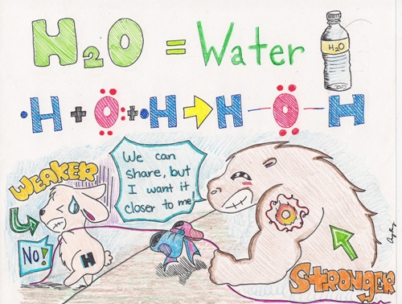

Slide 22
Nonpolar Molecules
H₂ is a nonpolar molecule
Two hydrogen atoms are identical, their attraction for the shared electrons is equal
A nonpolar compound will not easily dissolve in a polar compound, but will in other nonpolar compounds.
Oil (nonpolar) will not dissolve in water (polar)

Slide 23
Chemical Formulas and Molecular Models
A chemical formula is a group of chemical symbols and numbers that represent the elements and the number of atoms of each element that make up a compound.
Lists the elements in a compound
A subscript shows the number of atoms of each element
Does not explain the shape
Ways to model a molecule page 394 Figure 10

Slide 24
Lesson 3: Ionic and Metallic Bonds
Vocab words: ion, ionic bond, metallic bond

Slide 25
Understanding Ions
When an nonmetal and metal bond, they do not share electrons.
Instead one or more valence electrons transfer from the metal atom to the nonmetal atom.
The atoms then bond and form a chemically stable compound.
When an atom loses or gains a valence electron, it becomes an ion.
An ion is an atom that is no longer electrically neutral because it has lost or gained valence electrons.

Slide 26
Ions
If an atom loses valence electrons…
Positive charge
Number of protons is greater than the number of electrons
What type of ion is this?
CATION
If an atom gains valence electrons…
Negative charge
Number of electrons is greater than the number of protons
What type is this?
ANION

Slide 27
Losing Valence Electrons
Metal atoms, such as sodium, become more stable when they lose valence electrons and form a chemical bond with a nonmetal.
How many electrons would sodium have if it lost an electron?
10: the electrons in the next lower energy level are now the new valence electrons.
Sodium now has 8 and is chemically stable like neon

Slide 28
Gaining Valence Electrons
Nonmetal atoms also gain valence electrons from metal atoms.
It gains noble gas arrangement.
Sodium becomes a positively charged ion.
(+) sign
Chlorine becomes a negatively charged ion.
(-) sign
Figure 11 on page 399

Slide 29
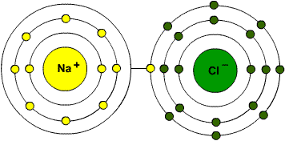
Ionic Bonds- Electron Transferring
In NaCl, a sodium atom loses valence electron and is transferred to the chlorine atom.
Sodium atom is +.
Chlorine atom is -.
These ions attract each other and form a stable ionic compound.
The attraction is called an ionic bond.

Slide 30
Ionic Compound
Ionic compounds characteristics:
usually solid and brittle at room temperature
High melting and boiling points
Many dissolve in water
Therefore, water that contains a dissolved ionic compound is a good conductor of electricity.
An electrical charge can pass from ion to ion.

Slide 31
Let’s Compare!
Covalent Compounds
Ionic Compounds
Share electrons
Between two or more nonmetals
Form molecules
Create covalent compounds (water) full of molecules
Covalent bonds
Gain or lose electrons
Between a nonmetal and metal
Form ions not molecules
Create ionic compounds full of oppositely charged ions held together by ionic bonds.

Slide 32
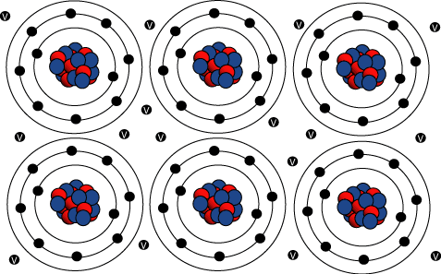
Metallic Bonds- Electron Pooling
Metals bond with other metals
Form compounds by pooling their valence electrons
A metallic bond is a bond formed when many metal atoms share their pooled valence electrons.

Slide 33
Metallic Bonds
Figure 13
The aluminum atoms lose their valence electrons and become positive ions.
Valence electrons move around from ion to ion.
They are not bonded to one atom
A “sea of electrons” surround the positive ions
They can move past each other to new positions.

Slide 34
Properties of Metallic Compounds
They can easily conduct an electric charge.
It is also very malleable and ductile.
Metals are shiny because they interact with light along the surface.
COPY CHART 402!!

