Slide 1
Chapter Two: the laws of motion

Slide 2
Lesson one: gravity and friction

Slide 3
Lesson 1: Gravity and Friction
Types of Forces
A push or pull on an object is called a __________
Example: pushed toothpaste out of the tube or pulled a chair out
An _____________________ can apply a force to another object or person.
Some forces are applied only when objects __________.
Others are applied when objects __________________.

Slide 4
Types of Forces
Contact Forces
A _____________ is a push or pull on one object by another that is touching it.
Contact forces can be weak and strong.
Noncontact Forces
A force that one object can apply to another object without touching it is a _________________________
________, the ___________force, and the _____________force are all examples.

Slide 5
Strength and Direction of Forces
Forces have both strength and direction.
What if you push a book away or push on the book?
Different things happen because the direction of _________________________.
___________ can be used to show forces
Length shows the strength
Stronger=_____________
Example: The tennis racquet vs. the table tennis paddle on page 46

Slide 6
Force
The SI unit for force is the ________________________

Slide 7
What is Gravity?
_____________is an attractive force that exists between all objects that have mass.
_________is the amount of matter in an object.
The Law of Universal Gravitation
In late 1600s, Sir Isaac Newton developed this:
All objects are ___________ to each other by a gravitational force.
The strength of the force depends on the _______of each object and ___________ between them.

Slide 8
The Law of Universal Gravitation
Gravitational Force and Mass
When the mass of one or both objects increases, the gravitational force between them also _________________.
Figure 4 on page 47
Each object exerts the ___________ attraction on the other object.
Gravitational Force and Distance
The attraction between objects ____________ as the distance between the objects ________.

Slide 9
Weight –A Gravitational Force
___________ is the gravitational force exerted on an object.
On Earth, the weight of an object in newtons is about ten times the object’s mass.
Weight and Mass High Above Earth
The moon’s gravity is 1/6
The moon is about ¼ of the Earth or 27%

Slide 10
Friction
Slide across the floor in your socks- you move quick and then stop
The force that stops you is friction
Friction is a _____________________________
________________________________________
________________________________________
Static Friction
Figure 7 on page 49
Box ________________ because the girl’s applied force is balanced by static friction

Slide 11
Static Friction
Static Friction ______________ surfaces from sliding past each other
Up to a limit, the strength of static friction changes to match the applied force
______________________________________
If the girl increases her applied force, will box move?
_____ because the static friction will also increase

Slide 12
Sliding Friction
When static friction reaches its limit between surfaces, the box will __________.
Sliding friction opposes the motion of surfaces _____________________________.
As long as it slides, the sliding friction does not change.
Increasing the applied force makes the box slide ___________.

Slide 13
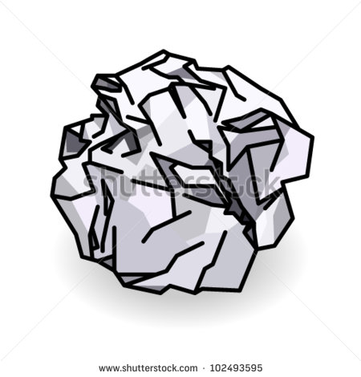
Fluid Friction
Friction between a surface and a fluid is ________________________.
Fluid friction between a surface and air is ________________________.
Decreasing the ______________________ toward the oncoming fluid decreases the air resistance against the object.
versus

Slide 14
What causes friction?
Microscopic dips and bumps cover all surfaces.
When surfaces slide past each other, the dips and bumps on one surface catch on the dips and bumps on the other surface.
This slows __________ and is a source of friction
Atoms and molecules make up all surfaces as well.
How to reduce friction?
Soap acts as a lubricant and ___________ friction.
It is easier for surfaces to slide past each other.

Slide 15
Lesson two: Newton’s first law of motion

Slide 16
Identifying Forces
Combining Forces- Net Forces
When two or more forces act on an object, forces combine.
______________________________________________________________________ is the net force.
The way in which forces combine depends on the _____________________________ applied to the object.

Slide 17
Identifying Forces
Combining Forces in the Same Direction
The direction of the net force is the same as the direction of the individual forces.
Combining Forces in Opposite Directions
The net force is the sum of the positive and negative forces

Slide 18
Identifying Forces
Balanced and Unbalanced
When two forces acting on an object in opposite directions are the ______________
_____________, the forces are ____________.
The net force is ________
Forces acting on an object that combine and form a _______________________________ __________ are ______________________.

Slide 19
Therefore…
Balanced forces ____________________
_______________________________________________________________________.
Unbalanced forces put a stationary object into ____________ (__________________
____________________) or change the _____________________of a moving object.

Slide 20
Newton’s First Law of Motion
Law of Inertia
WRITE NEWTON’S FIRST LAW OF MOTION ON THE SIDE →
Balance Forces and Motion
Balanced forces ___________________________
__________________________________________
This is true when an object is at rest or in motion
Figure 13 and 14

Slide 21
Newton’s First Law of Motion
Unbalanced Forces and Motion
When unbalanced forces act on an object at rest, the object starts __________
When unbalanced forces act on an already moving object, the object’s _________________________________
__________________________________

Slide 22
Newton’s First Law of Motion
Inertia
The tendency of an object to ____________
____________________
The motion of the crash-test dummy explains inertia
Before the crash:
If no force was applied:
The unbalanced force:
The dummy:

Slide 23
APPLY IT!
State how friction and inertia together affect an object’s movement
A book sitting on a table
________________________________________________________________________________________________________________________________________________________________________
What if there was no friction?
______________________________________________________________________________

Slide 24
On Earth, friction can be _____________________________________
For an object to move, a force greater than static friction must be applied to it
To keep the object moving, a force at least as strong as friction must be applied continuously
Objects stop moving when __________ or another force acts on them.

Slide 25
Lesson three: Newton’s second law of motion

Slide 26
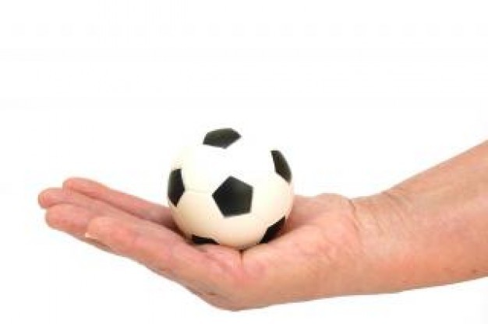
How do forces change motion?
Unbalanced Forces and Velocity
Only ________________ forces change an object’s velocity.
Unbalanced Forces on an Object at Rest
The forces are balanced= ball does _______________
When the hand moves out of the way, the ball falls downward.
It is unbalanced because the ball’s motion _______________.

Slide 27
Unbalanced Forces
When unbalanced forces act on an object at rest, the object begins moving in the direction of the ______________.
Unbalanced Forces on an Object in Motion
Unbalanced forces change the velocity of a moving object.
One way to change an object’s velocity is to change its ___________

Slide 28
Unbalanced Forces on an Object in Motion
___________________
If the net force acting on a moving object is in the ____________ that the object is __________ , the object will _________________ .
___________________
If the net force on an object is __________ to the direction the object moves, the object _________
When the boy pushes his foot against the snow, __________ acts in the opposite direction to his motion

Slide 29
Changes in Direction of Motion
Unbalanced forces can change an object’s velocity ____________________________
Think about a game of pool
The ball is moving a _________________ until it hits the rail.
The applied force by the rail changes the ball’s _________________
Another example is Earth’s crust

Slide 30
Unbalanced Forces and Acceleration
Recall : what is acceleration?
When the girl pushed the sled, did the sled accelerate?
When the ball hit the side of the table, did the ball accelerate?
Unbalanced forces can make an object ______________________________________________________________________

Slide 31
Newton’s Second Law of Motion
Write Newton’s 2nd Law →
Acceleration (in m/s²) = _____________(in N) / _______(in kg)
A=F/m
OR
F= ma
** Newton is the same as kg*m/s²**

Slide 32
Examples
You throw a 0.5 kg basketball with a force of 10 N. What is the acceleration of the ball?
A 24-N net force acts on an 8-kg rock. What is the acceleration of the rock?
A 30-N net force on a skater produces an acceleration of 0.6 m/s². what is the mass of the skater?
What net force acting on a 14-kg wagon produces an acceleration of 1.5 m/s²?

Slide 33
Circular Motion
A circular motion is _________________
_______________________________________________________________________.
In circular motion, _____________________
_________________________________________________________________________________________________________________________________, is centripetal force.

Slide 34
Centripetal Force
The path of inertia shows its tendency to stay on a _____________ path & creates motion.
However, the path is curved because of the string= ______________
_____________________
Acceleration is: ____________________

Slide 35
The Motion of Satellites and Planets
Satellite and planets in orbit
Inertia: _________________
Centripetal force: _____________
Why? _______________________________
Car making a turn(circular motion)
Inertia: _________________
Centripetal force: __________

Slide 36
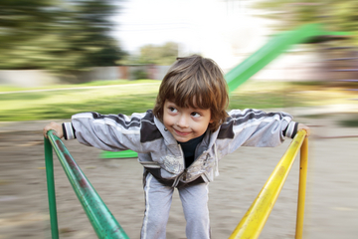
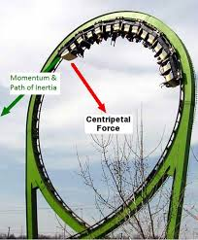
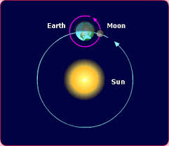
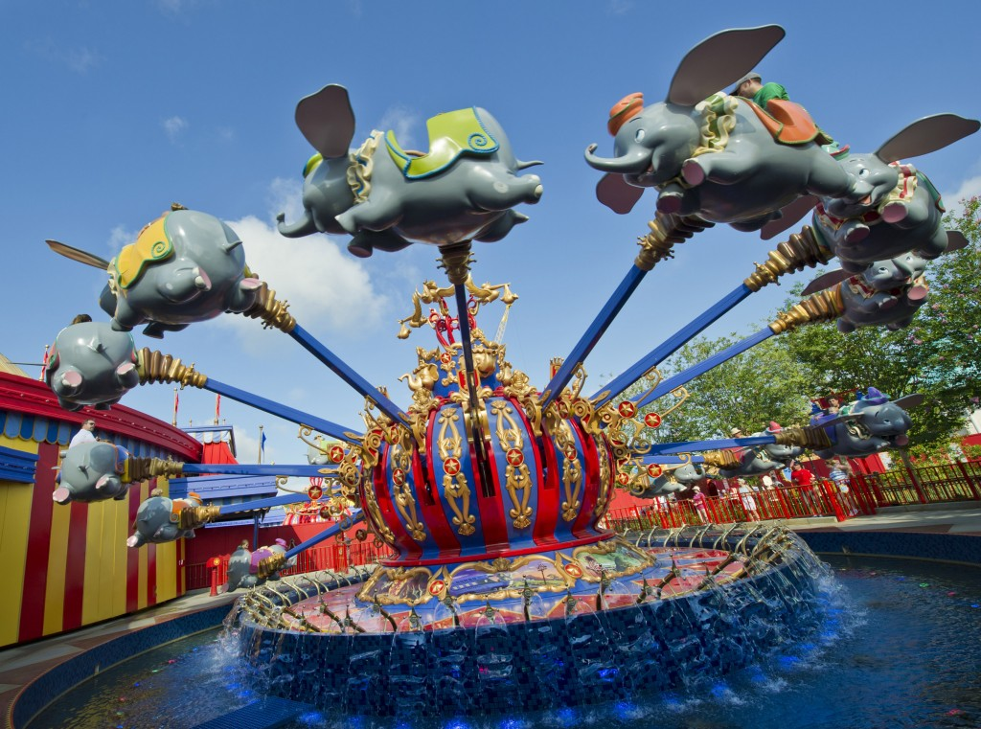
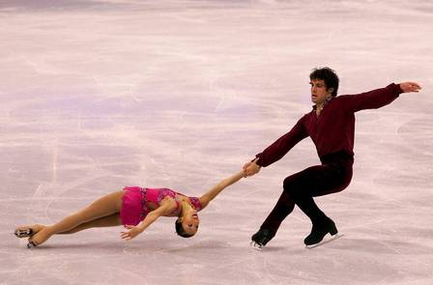
WHY ARE ALL OF THESE EXAMPLES OF CENTRIPETAL FORCE?

Slide 37
Lesson four: newton’s third law of motion

Slide 38
Opposite Forces
When an object applies a force on another object, the second object applies a force of the _________________on the first object, but the force is in the _________________
Newton’s Third Law of Motion
Relates to _____ objects
WRITE NEWTON’S THIRD LAW OF MOTION →

Slide 39
Force Pairs
The forces depend on __________________.
A force pair is _________________________
______________________________________
If the forces of a force pair always act in opposite directions and are always the same strength, do they cancel each other out?
__________________________________________________________________________

Slide 40
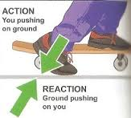
Net force is not zero because they are acting __________________________
__________________________.
Adding forces can only result in a net force of zero, in this case, if the forces act on the same object
For every action force, there is a reaction force that is _______in strength but ____________ in direction

Slide 41
Using Newton’s Third Law of Motion
Swimming
________ force is against the water in the pool
___________force is against you
If your arms push the water back with enough force, the reaction of the water on your body is greater than the force of fluid friction.
The net force is _________________
You accelerate in the direction of the net force and swim forward through the water

Slide 42
Jumping
You push _________on the ground
Ground pushes ______on you
If you push down hard enough, the upward reaction force is greater than the downward force of gravity
The net force is ______________
Based on Newton’s 2nd Law, your acceleration is in the same direction as the net force. Therefore, you accelerate upward

Slide 43
Momentum
Momentum is a __________________________
_________________________________________
It is the product of an object’s mass and velocity
It is in the same direction as its velocity
p= m * v

Slide 44
Which is harder to stop? A large truck or car
__________ is harder to stop because it has more mass and more momentum
What if the car and truck are equal in mass but move at different speeds?
The one that moves __________ has greater momentum.

Slide 45
Examples
What is the momentum of a 12 kg bicycle moving at 5.5 m/s?
What is the momentum of a 1.5 kg ball rolling at 3.0 m/s?
A 55 kg woman has a momentum of 220 kg*m/s. What is her velocity?

Slide 46
Conservation of Momentum
If a moving ball hits another ball that is not moving, the motion of both balls changes.
The cue ball has momentum because it has mass and is moving
When the cue ball hits the other balls, the cue ball’s velocity and momentum decrease
The other billiard balls start moving
These have mass and velocity; they also have momentum

Slide 47
The Law of Conservation of Momentum
The billiard balls ______momentum that the cue ball _________
The total momentum does not change
The law states: The total momentum of a group of objects ________________ unless outside forces act on the objects
Outside forces include friction
___________ between the balls and the table decreases their velocities and they lose momentum

Slide 48
Types of Collisions
Elastic collisions
When colliding objects ________________ each other
Inelastic collision
When objects collide ______________________
Such as when one football player tackles another
No matter the type of collision, the total momentum will be the same before and after the collision

Slide 49
http://www.sciencechannel.com/games-and-interactives/newtons-laws-of-motion-interactive.htm

