Slide 1
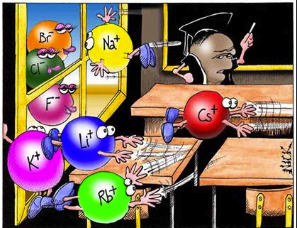
Chapter 11: Elements and Chemical Bonds

Slide 2
Lesson 1:Electrons & Energy Levels
Vocab words: chemical bond, valence electron, electron dot diagram

Slide 3
What are Chemical Bonds?
Pure elements are rare. Atoms of different elements chemically combine and form compounds.
____________________ make up most of the matter around you.
Chemical bonds hold them together.
A _____________________ is a force that holds two or more atoms together.

Slide 4
Electrons and Energy
The areas around which the electrons move around the nucleus are called ______________________.
If an electron has the least amount of energy, where are they located?
____________ to the nucleus or the lowest energy level
If an electron has the greatest amount of energy, where are they located?
_____________ away or the highest energy level

Slide 5
Electrons and Bonding
The electrons closest to the nucleus of the same atom have a _______________to that nucleus.
The electrons farther away nucleus are ________ attracted to it. These outermost electrons can easily be attracted to the nucleus of other atoms.
This attraction between the ____________ of an atom and the _____________ of another is what causes a chemical bond.

Slide 6
Valence Electrons
A __________________ is an outermost electron of an atom that participates in chemical bonding.
These electrons are the ______ electrons involved in chemical bonding.
Lewis dot diagram can help you predict how an atom will bond with other atoms.
The _____________________ is often the number of bonds an atom can form.

Slide 7
Stable and Unstable Atoms
Atoms with one to seven valence electrons are chemically _____________.
Atoms with unpaired dots are __________.
They form bonds with other atoms.
They become more stable by forming bonds.
When an atom forms a bond, it gains, loses, or shares _________________ with other atoms.

Slide 8
Lesson 3: Ionic and Metallic Bonds
Vocab words: ion, ionic bond, metallic bond

Slide 9
Understanding Ions
When an _____________and _________bond, they do not share electrons.
Instead one or more valence electrons ____________ from the metal atom to the nonmetal atom.
The atoms then bond and form a chemically stable compound.
When an atom loses or gains a valence electron, it becomes an __________.
An ion is an atom that is no ______________________ _________________ because it has lost or gained valence electrons.

Slide 10
Losing Valence Electrons
Metal atoms, such as sodium, become more stable when they lose valence electrons and form a chemical bond with a nonmetal.
How many electrons would sodium have if it lost an electron?
__________ : the electrons in the ________________________level are now the new valence electrons.
Sodium now has ____ in its outer shell and is chemically _________like neon

Slide 11
Gaining Valence Electrons
Nonmetal atoms tends to _______ valence electrons from metal atoms.
Atoms with __________ VE gain (nonmetals) to become stable.
Atoms with _________ VE lose (metals). They are left with a filled energy level.

Slide 12
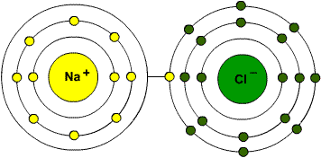
Ionic Bonds- Electron Transferring
In NaCl, a ________atom loses valence electron and is transferred to the ________________atom.
Sodium atom is +.
Chlorine atom is -.
These ions attract each other and form a stable ionic compound.
The attraction is called an ___________________.

Slide 13
Polyatomic Ions
Ions made of more than 1 atom. They act as a single atom. Ex: SO₄²⁻ ___________
NAMING IONIC COMPOUNDS
Positive ion (_______ ) comes first followed by the negative ion (__________).
If the negative ion is an element- ______ending
MgO: _______________

Slide 14
Ionic Compound
Ionic compounds characteristics:
usually _______and _________at room temperature
High melting and boiling points
Many dissolve in water
Therefore, water that contains a dissolved ionic compound is a good _____________of electricity.
An electrical charge can pass _____________________________.

Slide 15
Let’s Compare!
Covalent Compounds
Ionic Compounds
__________electrons
Between two or more _______________
Form molecules
Create covalent compounds (water) full of molecules
Covalent bonds
___________________electrons
Between a nonmetal and _____________
Form ions not molecules
Create ionic compounds full of oppositely charged ions held together by ionic bonds.

Slide 16
Lesson 2: Compounds, Chemical Formulas, and Covalent Bonds
Vocab words: covalent bonds, molecule, polar molecule, chemical formula

Slide 17
Covalent Bonds- Electron Sharing
Atoms can become stable by sharing electrons.
______________ bond together by the sharing.
A ___________________ is a chemical bond formed when two atoms share one or more pairs of valence electrons.
The atoms then form a stable covalent compound.

Slide 18
Hydrogen and Oxygen
Hydrogen and oxygen
Hydrogen has one valence electron
Oxygen has six valence electron
Atoms are stable with ____: this is considered a noble gas arrangement. This is also called the _________________
To become stable, oxygen atom forms ______ bonds and hydrogen atom forms ______ bond (only two valence electrons)

Slide 19
Stable
An oxygen atom and each hydrogen atom ________ the electrons, and form two ___________bonds to become stable covalent compound.
Each bond contains ______________ : one from the H atom and one from the O atom
The valence electrons count for _______________ in the bond.
Hydrogen has ______and oxygen has _________since it bonds with two hydrogen atoms.

Slide 20
Double and Triple Covalent Bonds
_________covalent- 2 atoms share _____ pair of valence electrons.
Carbon dioxide
________covalent- 2 atoms share _____pairs of valence electrons.
_________covalent- 2 atoms share ______pairs of valence electrons.

Slide 21
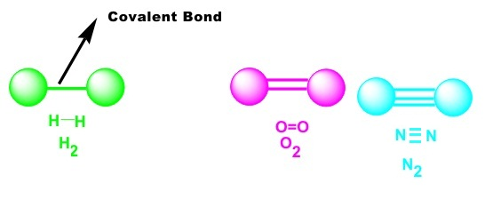
Find the type of covalent bond.
H₂
O₂
N₂

Slide 22
Molecules and Properties
A ________________ is a group of atoms held together by covalent bonding that acts as an independent unit.
Table sugar (C₁₂H₂₂O₁₁) is a covalent compound.
Weaker bonds than Ionic
Low melting and boiling points
Poor conductors of electricity

Slide 23
Water and Other Polar Molecules
In a covalent bond, one atom can attract the shared electrons more _________ than the other atom can.
In a water molecule, the ___________atom attracts the shared electrons more strongly than the hydrogen atom does.
Shared electrons are pulled __________ to the oxygen atom
Oxygen atom has a partial ________charge
Hydrogen atom has a partial _______charge

Slide 24
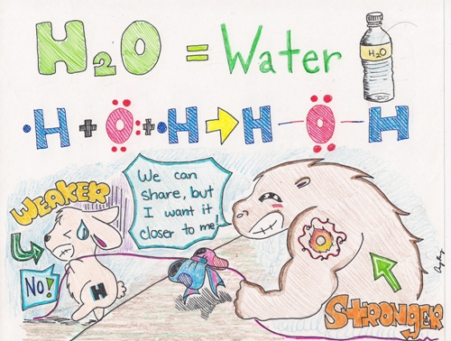

Slide 25
Continued…
A molecule that has a partial positive end and a partial negative end because of unequal sharing of electrons is a ____________________________.
Soap is _______ on one end and _______on the other. Soap attracts the polar end of ______and the nonpolar end of ___________.

Slide 26
Nonpolar Molecules
H₂ is a nonpolar molecule
Two hydrogen atoms are ______________, their attraction for the shared electrons is __________
A nonpolar compound _____________________ in a polar compound, but will in other nonpolar compounds.
_________(nonpolar) will not dissolve in water (polar)

Slide 27
Chemical Formulas
A chemical formula is a group of chemical symbols and numbers that represent the elements and the number of atoms of each element that make up a compound.
Lists the elements in a compound
A subscript shows the number of atoms of each element

