Slide 1
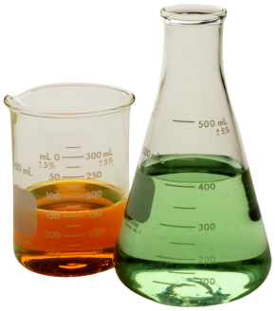
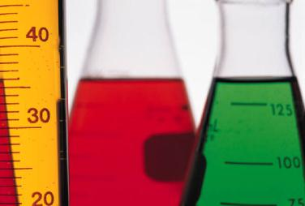
Chapter 7: Foundations of Chemistry
Lessons 7.1, 7.2, & 8.1

Slide 2
Lesson 7.1: Classifying Matter
Vocab words: matter, atom, substance, element, compound, mixture, heterogeneous mixture, homogeneous mixture, dissolve

Slide 3
Understanding Matter
Matter is anything that has mass and takes up space.
Everything you see is matter
Air is matter
Sound and light are not
Forces and energy are not
An atom is a small particle that is a building block of matter.

Slide 4
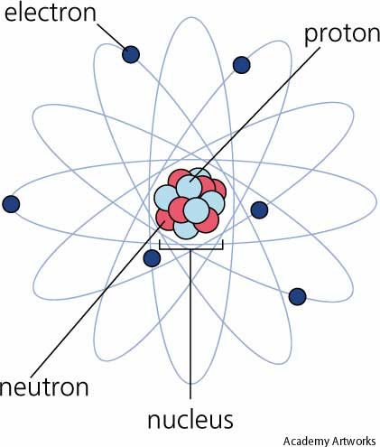
Atoms
At the center of an atom is a nucleus.
protons (positive charge) and neutrons (neutral charge) make up the nucleus
Electrons (negative charge) move around the nucleus called the electron cloud
https://www.ted.com/talks/just_how_small_is_an_atom

Slide 5
Atoms
Not all atoms have the same number of protons, neutrons, and electrons.
Atoms have different number of protons therefore, they differ in their properties.
Atoms determine the properties of the matter they compose.

Slide 6
Substances
These different combinations of atoms are what makes up the various types of matter.
Two main classifications
Substances
Mixtures

Slide 7
Substances
A substance is matter with a composition that is always the same.
Same combo of atoms
Aluminum, water, oxygen are all examples
Two types of substances:
Elements
compounds

Slide 8
Elements
An element is a substance that consists of just one type of atom.
115 elements= 115 types of atoms
Contains a different number of protons in its nucleus
Atomic number: number of protons in the nucleus
Mass number: weight of an atom (protons and neutrons)

Slide 9
Elements
The atoms of most elements exist as individual atoms.
However, the atoms of some elements usually exist in groups.
Oxygen atoms in the air exist in pairs
No matter what, each element contains only one type of atom.
Composition is the same

Slide 10
Compounds
A compound is a type of substance containing atoms of two or more different elements chemically bonded together.
Carbon dioxide
Carbon, oxygen
Are always combined in the same way

Slide 11
Chemical Formulas
The combination of symbols and numbers that represents a compound
C.F. show the different atoms that make up a compound
Also explain how the atoms combine
CO₂ : 2 Oxygen atoms with 1 Carbon atom
2 is a subscript
No subscript- 1 atom

Slide 12
Properties of Compounds
Compound has different properties from the individual elements that make it up.
Carbon is a black solid
Oxygen is a gas that enables fuels to burn
Combine them → gas used to extinguish fires.
Compounds are substances that have their own properties

Slide 13
Mixtures
A mixture is matter that can vary in composition.
Combinations of two or more substances that are physically blended together.
Amounts can vary
Ex: sand and water
Do not combine chemically; Can be separated physically
They differ depending on how well they are mixed

Slide 14
Heterogeneous mixtures
Sand is not evenly mixed throughout the water
A heterogeneous mixture is a type of mixture in which the individual substances are not evenly mixed.
Therefore, two samples of the same mixture can have different amounts of the substances
One bucket might have more sand than the other.

Slide 15
Homogeneous Mixtures
Homogeneous mixture is a type of mixture in which the individual substances are evenly mixed.
The particles of individual substances are so small and well-mixed that they are not visible
Also known as a solution

Slide 16
In a solution
The substance present in the largest amount is called the solvent.
All other substances are called solutes.
The solutes dissolve in the solvent.
Dissolve means to form a solution by mixing evenly

Slide 17
Homogeneous mixtures
Two samples from a solution will have the same amounts of each substance
Two glasses of apple juice
Each will have the same substances in same amounts
However, the amounts of the substances from one container to another might vary

Slide 18
Compounds vs. Solutions
Water=compound
Pure water is made up the same atoms in the same combination
Combination doesn’t vary.
Therefore, it has chemical formula of H₂O

Slide 19
Continued…
Salt water = homogeneous mixture
Solute(NaCl) & Solvent(H₂O) are evenly mixed but not bonded together
By changing the amounts of substance, the composition just varies. A formula cannot be used.
Chart on page 236

Slide 20
Lesson 7.2: Physical Properties
Vocab words: physical property, mass, density, solubility

Slide 21
Physical Property
A physical property is a characteristic of matter that you can observe or measure without changing the identity of the matter.
States of matter

Slide 22
States of Matter
Solids, liquids, and gases
Substances and mixtures can be any of these three
Ocean is a liquid
Water in an iceberg is a solid
Water vapor in the air above the ocean is a gas

Slide 23
Solid, liquid, gas
Are all made up of particles that attract to one another. It depends on how close they are to one another and how fast they move
Solid: particles are very close together and vibrate back and forth. Solids cannot easily change shape.(definite shape and volume)

Slide 24
Continued…
Liquid: particles have more energy(more motion) than the particles in a solid. Each particle still touches the ones around it, but the particles slide past each other. This is why you can pour a liquid.
(definite volume & indefinite shape)
Gas: the particles move very quickly, spread out, and fill their container.
(indefinite volume & shape)

Slide 25
Mass
The amount of matter in an object.
Mass vs. weight
Mass is an amount
Weight is the pull of gravity on that matter
Weight changes due to location
Dumbell’s mass on the Earth and on the moon would be the same
But it’s weight would be less on the moon than on Earth bc the moon has less gravity

Slide 26
Volume
The amount of space something takes up
Unit: milliliter

Slide 27
Melting point & boiling point
Melting point: the temperature at which a substance changes from a solid to a liquid
Boiling point: the temperature at which a substance changes from a liquid to a gas
Different substances have different boiling and melting points
Does not depend on how much water is in the container

Slide 28
Density
The mass per unit volume of a substance
If an object is denser it sinks
If an object is less dense it floats
This does not depend on size
For example, if I cut a 10 g rock in half that takes of 5 cm³ of space, does its mass change? Volume? Density? →

Slide 29
Conductivity
Electrical conductivity: the ability of matter to conduct an electric current
Copper- high conductivity
Thermal conductivity: the ability of a material to conduct thermal energy
Metals-have thermal and electrical
Does not depend on size

Slide 30
….
Stainless steel
Cooking pots are made out of because of its high thermal conductivity
Handle of the pan is made of wood, plastic, or some other substance that has a low thermal conductivity (also known as an ___________)

Slide 31
Solubility
The ability of one substance to dissolve in another
The lemonade powder mix is soluble in water
Lemonade powder is the ______________
Water is the __________
Sand does not mix in water

Slide 32
Separating mixtures
When forming a mixture, the properties of the individual substances do not change
Mixtures can be separated by physical properties
Salt and water do not lose their individual properties
Separate by using differences in their properties
Water has a lower boiling point
So what can you do?
Therefore, salt will get left behind.

Slide 33
…
Physical properties cannot be used to separate a compound into the elements it contains.
The atoms that make up a compound are bonded together and cannot be separated by physical means
Table 1 on pages 244 & 245

Slide 34
Lesson 8.1: Solids, Liquids, and Gases
Vocab: solid, liquid, viscosity, surface tension, gas, vapor

Slide 35
Describing Matter
Three states of matter
Solids, liquids, gases
Fourth state of mater- plasma
A high-energy matter consisting of positively and negatively charged particles
Most common in space
Lightning flashes, fluorescent lighting, and stars such as the Sun

Slide 36
Describing Matter
Use your senses to describe matter
Using measurements
Mass: g or kg
Volume: L or mL , cm³ or m³
Density: g/cm³ or g/mL
Remains constant bc it is size-independent

Slide 37
Particles in Motion
Two factors that determine the state of matter are particle motion and particle forces.
Particles (atoms, ions, or molecules) vibrate or move freely
Regardless of closeness, they all move in random motion
In all directions and different speeds
In straight lines until there is a collision
Change the speed and direction

Slide 38
Forces Between Particles
Motion slows
Particles move close together and pulls them toward each other
Strong attractive forces
Motion increases
Particles move farther apart &the forces get weaker
Space between increases and slide past each other

Slide 39
Forces Between Particles
Motion continues to increase
The particles move even farther apart
With the distance increasing, there is little or no attractive forces between the particles
They can move randomly

Slide 40
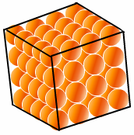
Solids
A matter that has a definite shape and definite volume
Particles are tightly packed
Strong attractive forces and hold them close together
Slow motion of particles
Particles vibrate back and forth

Slide 41
Types of Solids
All solids are not the same
Diamond vs. charcoal
Arrangement of particles are different
Diamond- crystalline solid
Arranged specific, repeating order
Charcoal- amorphous solid
Arranged randomly
These different arrangements give different properties
Diamond- hard Charcoal-brittle

Slide 42
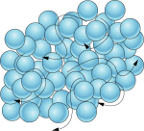
Liquids
A matter with a definite volume but no definite shape
Particles move faster than in a solid
Slightly farther apart
Attractive forces decrease
Particles can slide past each other

Slide 43
Viscosity
A measurement of a liquid’s resistance to flow
Is due to particle mass, particle shape, and strength of the attraction between particles
Stronger the attraction- higher viscosity
As a liquid get warmers, viscosity decreases
Particles move faster and the force weakens. The particles can slide past each other easily

Slide 44
Viscosity
The mass and shape affect viscosity
Large particles or with complex shapes tend to move more slowly and have difficulty sliding past one another
Honey has a high viscosity
Water has a low viscosity

Slide 45
Surface Tension
Water molecules below the surface are surrounded by other water molecules
The attraction between them is called cohesion
Water molecules at the surface of a liquid don’t have molecules above them.
Downward pull is greater
Those particles are stretched

Slide 46
Surface Tension
Those molecules at the surface have surface tension
The uneven forces acting on the particles on the surface of a liquid
This allows a spider to walk on water
The thin water-soap film around the bubbles forms because of it
The stronger the attractive force, the greater the surface tension

Slide 47
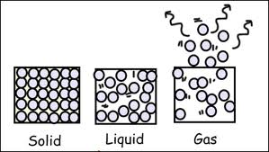
Gases
A matter that has no definite volume and no definite shape
Particles move even faster and freely
Particles move even farther apart
Slight or weak attractive forces
Particles spread out to fill their container

Slide 48
Vapor
The gas state of a substance that is normally a solid or a liquid at room temperature
At room temp, water is a liquid
When in a gas state (in the air), it is called water vapor
Rubbing alcohol, iodine, mercury, and gasoline can form a vapor

