Slide 1
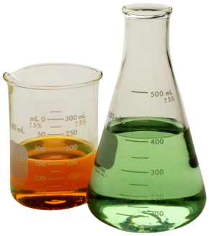
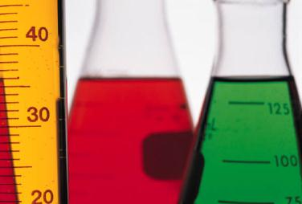
Chapter 7: Foundations of Chemistry
Lessons 7.1 ,7.2, & 8.1

Slide 2
Lesson 7.1: Classifying Matter
Vocab words: matter, atom, substance, element, compound, mixture, heterogeneous mixture, homogeneous mixture, dissolve

Slide 3
Understanding Matter
_______________ is anything that has mass and takes up space.
Everything you see is matter
Air is matter
Sound and light are not
Forces and energy are not
An ___________ is a small particle that is a building block of matter.

Slide 4
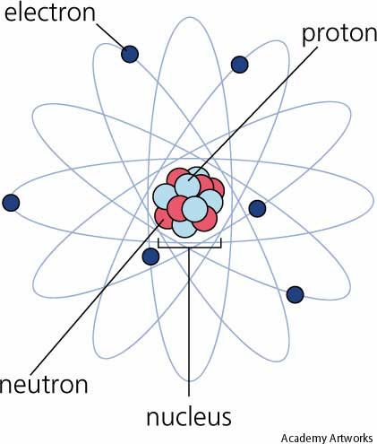
Atoms
At the center of an atom is a ___________.
_______ (positive charge) and __________ (neutral charge) make up the nucleus
__________ (negative charge) move around the nucleus called the electron cloud
https://www.ted.com/talks/just_how_small_is_an_atom

Slide 5
Atoms
Not all atoms have the ______ number of protons, neutrons, and electrons.
Atoms have different number of _______ therefore, they differ in their properties.
Atoms determine the properties of the matter they compose.

Slide 6
Substances
These different combinations of atoms are what makes up the various types of matter.
Two main classifications
______________
______________

Slide 7
Substances
A ____________ is matter with a composition that is always the same.
Same combo of atoms
Aluminum, water, oxygen are all examples
Two types of substances:
_____________
_____________

Slide 8
Elements
An element is a substance that consists of just ______________________________.
115 elements= 115 types of atoms
Contains a different number of ________ in its nucleus
Atomic number: number of ________ in the nucleus
Mass number: weight of an atom (_________________________)

Slide 9
Elements
The atoms of most elements exist as individual atoms.
However, the atoms of some elements usually exist in groups.
Oxygen atoms in the air _____________
No matter what, each element contains only one type of atom.
Composition is the same

Slide 10
Compounds
A ______________ is a type of substance containing atoms of ______________ different elements _______________ together.
Carbon dioxide
Carbon, oxygen
Are always combined in the same way
Formulas show the ratio of elements in a compound: CO², H₂O, H₂O₂

Slide 11
Properties of Compounds
Compound has ____________ properties from the individual elements that make it up.
Carbon is a black solid
Oxygen is a gas that enables fuels to burn
Combine them → gas used to extinguish fires.
Compounds are substances that have their _______________________

Slide 12
Mixtures
A mixture is matter ___________________
____________________________________
Combinations of two or more substances that are ______________________together.
Amounts can vary
Ex: sand and water
Do not combine chemically; Can be separated ________________
They differ depending on how well they are _____________

Slide 13
__________________ mixtures
Sand is not evenly mixed throughout the water.
A ____________ is a type of mixture in which the individual substances are _____________
____________________
Therefore, two samples of the same mixture can have ______________ amounts of the substances
One bucket might have more sand than the other.

Slide 14
Homogeneous Mixtures
______________ is a type of mixture in which the individual substances are __________________________.
The particles of individual substances are so small and well-mixed that they are _____________________
Also known as a _______________

Slide 15
In a solution
The substance present in the largest amount is called the __________
All other substances are called _________.
The solutes dissolve in the ____________.
____________ means to form a solution by mixing evenly
Salt water= homogeneous mixture
Solute (NaCl) & Solvent (H₂O) are _______________ but not ________ together

Slide 17
Lesson 7.2: Physical Properties
Vocab words: physical property, mass, density, solubility

Slide 18
Physical Property
A ________________ is a characteristic of matter that you can observe or measure without changing the identity of the matter.
Physical properties can be _____________________(dependent on the size or amount) or size-independent (___________________ on the size)

Slide 19
Size-dependent properties
____________
____________

Slide 20
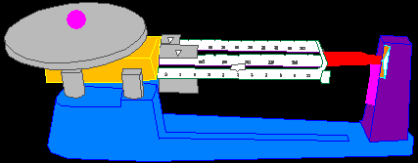
Mass
The _____________________ in an object.
Basic SI unit (Kg) ____________
Tool to measure mass – _________________

Slide 21
Mass versus Weight
Mass is the ___________________________
Weight is the _________________on that matter
Basic unit: (N) ______________
Weight changes due to ____________
Dumbell’s _________ on the Earth and on the moon would be the same
But it’s ________would be less on the moon than on Earth bc the moon has ______________
Roughly 1/6 of your weight on the Earth

Slide 22
Volume
The amount of ________ something takes up
Basic units:
Solids- ______
Liquids- (L) _________
Graduated cylinder (___________________)
Metric ruler (_____________solids)
Formula:
__________x __________x _________
Cm x cm x cm = cm³

Slide 23
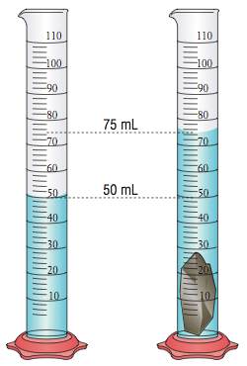
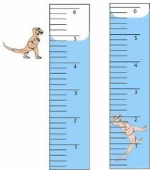
Volume of an irregularly shaped object:
Use a graduated cylinder
Measure the change in water level
***1mL= 1cm³

Slide 24
Melting point & boiling point
_________ point: the temperature at which a substance changes from a ____________________
_________ point: the temperature at which a substance changes from a ____________________
Does not depend on how much water is in the container
Density: _______________________of a substance
____________ : the ability of matter to __________ an electric current/conduct thermal energy
Copper/ metals/ stainless steel

Slide 25
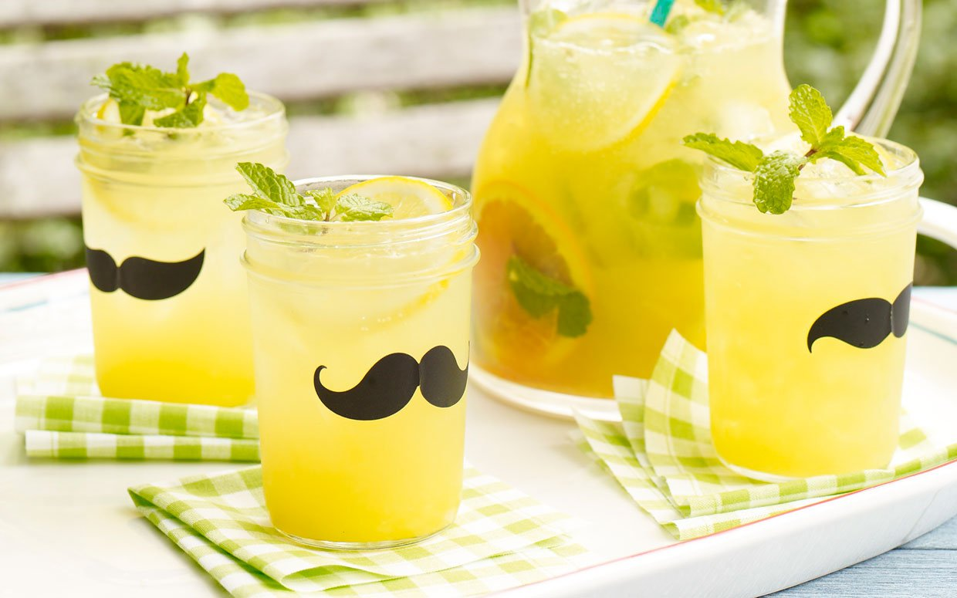
Size- Independent Property
______________ : the ability of one substance to dissolve in another
The lemonade powder mix is soluble in water
Lemonade powder is the ______________
Water is the __________
____________: attractive force for
some metals

Slide 26
Calculate Density
Formula:
Density =_______
Basic unit solid- _________________________
Density of water = _________
For example, if I cut a 10 g rock in half that takes of 5 cm³ of space, does its mass change? Volume? Density? →

Slide 27
Separating mixtures
When forming a mixture, the properties of the individual substances do not change
Mixtures can be separated by _____________
Salt and water do not lose their individual properties
Separate by using differences in their properties
Water has a lower boiling point
So what can you do? __________________
Therefore, __________________________

Slide 28
Lesson 8.1: Solids, Liquids, and Gases
Vocab: solid, liquid, viscosity, surface tension, gas, vapor

Slide 29
Particles in Motion
Two factors that determine the state of matter are particle ________and particle ________.
Particles (atoms, ions, or molecules) vibrate or move freely
Regardless of closeness, they all move in random motion
In all directions and different speeds
In straight lines until there is a collision
Change the speed and direction

Slide 30
Forces Between Particles
Motion slows
Particles move close together and pulls them toward each other
_______________________
Motion increases
Particles move ______________& the forces get ___________
Space between ____________ and slide past each other

Slide 31
Forces Between Particles
Motion continues to increase
The particles move even farther apart
With the distance increasing, there is _________________ attractive forces between the particles
They can move _____________

Slide 32
Describing Matter
Three states of matter
Solids, liquids, gases
Fourth state of mater- ____________
A high-energy matter consisting of positively and negatively charged particles
Most common in space
______________, fluorescent lighting, and stars such as the ______

Slide 33
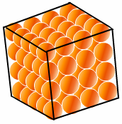
Solids
A matter that has a ________shape and ____________volume
Particles are tightly packed
____________ attractive forces and hold them close together
Slow motion of particles
Particles vibrate back and forth

Slide 34
Types of Solids
All solids are not the same
Diamond vs. charcoal
Arrangement of particles are different
Diamond- _____________ solid
Arranged specific, repeating order
Charcoal- _____________solid
Arranged randomly
These different arrangements give different properties
Diamond- ______ Charcoal-_______

Slide 35
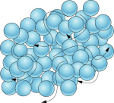
Liquids
A matter with a ________volume but __________ shape
Particles move faster (more energy) than in a solid
Slightly farther apart
Attractive forces _______________
Particles can slide past each other
Each particle still touches the ones around them. Particles can slide past each other: This is why you can _________________________

Slide 36
Viscosity
A measurement of a liquid’s ____________
_____________________________
Is due to particle mass, particle shape, and strength of the attraction between particles
Stronger the attraction- _________viscosity
As a liquid get warmers, viscosity ________
Particles move faster and the force _____________ . The particles can slide past each other easily.

Slide 37
Viscosity
The mass and shape affect viscosity
Large particles or with complex shapes tend to move more slowly and have difficulty sliding past one another
Honey has a ________viscosity
Water has a _________viscosity

Slide 38
Surface Tension
Water molecules below the surface are surrounded by other water molecules
The attraction between them is called _____________.
Water molecules at the surface of a liquid don’t have molecules above them.
Downward pull is greater
Those particles are _________________

Slide 39
Surface Tension
Those molecules at the surface have ____________________
The uneven forces acting on the particles on the surface of a liquid
This allows a spider to walk on water
The thin water-soap film around the ____________ forms because of it
The stronger the attractive force, the greater the surface tension

Slide 40
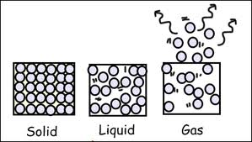
Gases
A matter that has __________ shape and __________
Particles move very quickly and freely
Particles move even farther apart
__________________ attractive forces
Particles spread out to ___________________

Slide 41
Vapor
The gas state of a substance that is normally a __________________________________
____________________________________
At room temp, water is a liquid
When in a gas state (in the air), it is called ___________________
Rubbing alcohol, iodine, mercury, and gasoline can form a __________

